Slide 1

Realization of analog circuits using FPAA KIT AND Familiarization WITH ANALOG DISCOVERY KIT
Presented by
Moumita Maji
B.Tech (ECE)
Under the Guidance of
Prof. Rahul Bhattacharya
Dept. of Electronics Engineering
IIT (ISM) Dhanbad

Slide 2
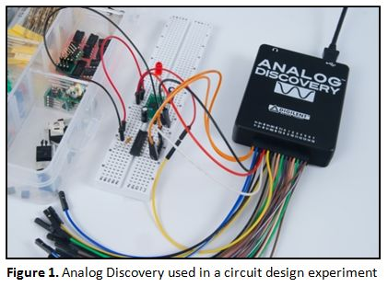
INTRODUCTION TO ANALOG DISCOVERY KIT
The Analog Discovery Kit is a small, low-cost device used to work with both analog and digital circuits
It works like multiple lab instruments combined in one device.
The kit connects to a computer via USB and is controlled using WaveForms software.
It is developed by Digilent, in partnership with Analog Devices Inc.
Simple wire probes allow easy connection to breadboards or circuit setups.

Slide 3
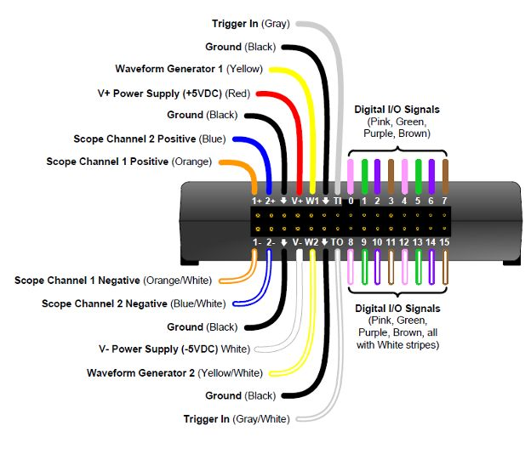
INTRODUCTION TO ANALOG DISCOVERY KIT
The Analog Discovery Kit can act as the following commonly used lab instruments:
2-Channel Oscilloscope: 1MΩ input impedance, ±25V range, 14-bit resolution, 100MS/s sampling, 5MHz bandwidth.
2-Channel Arbitrary Waveform Generator: 22Ω output, ±5V range, 100MS/s sampling.
Two Digital Trigger Inputs/Outputs for instrument synchronization .
Built-in Power Supplies: +5V and -5V at 50mA.
Network Analyzer: Frequency response plots (Bode, Nyquist, Nichols) from 1Hz to 10MHz.
Spectrum Analyzer: Measures spectral properties (noise, SNR, THD, SFDR)
The pin-out terminals of Analog Discovery Kit (AD Kit)

Slide 4
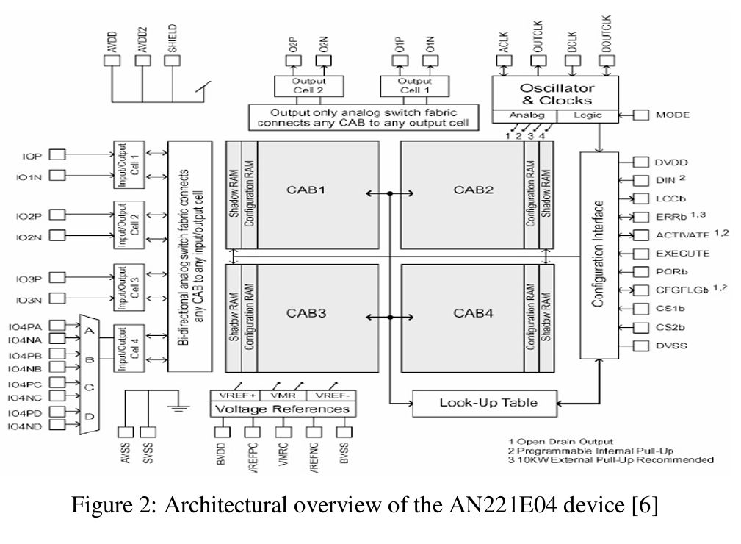
INTRODUCTION TO FPAA BOARD
4
FPAA stands for Field Programmable Analog Array — a reconfigurable chip used to implement analog circuits.
It works like an analog version of FPGA, but instead of digital logic, it processes analog signals.
Internally made up of Configurable Analog Blocks (CABs) that include:
Operational amplifiers (op-amps)
Programmable Switched capacitor banks
SAR based ADC
Uses CMOS technology and switched-capacitor techniques to simulate traditional analog components like resistors and filters.
Enables the implementation of analog functions such as:
Filters (low-pass, high-pass, band-pass)
Amplifiers (gain stages, summing)
Comparators, rectifiers, and oscillators
FPAA can be reprogrammed as needed, making it highly flexible and cost-effective for analog prototyping and learning.
Fig 2.3. Architectural overview of the AN231E04 device

Slide 5
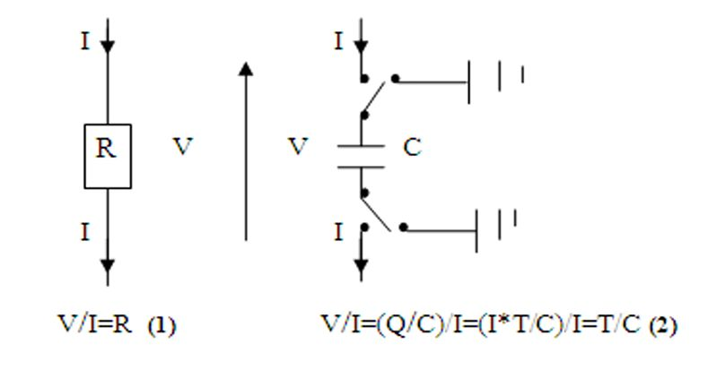
Technology and Principle Behind FPAA
FPAA is fabricated using CMOS technology, which integrates analog components (op-amps, capacitors, switches) on a single chip.
The core working principle is the Switched-Capacitor (SC) Technique, where:
Capacitors and electronic switches replace resistors.
Clock-controlled switching allows capacitors to simulate resistance and perform different functions.
The design relies on Configurable Analog Blocks (CABs), which use:
Programmable Capacitor Arrays (PCAs)
Dynamic and static switches to configure the internal circuit paths

Slide 6
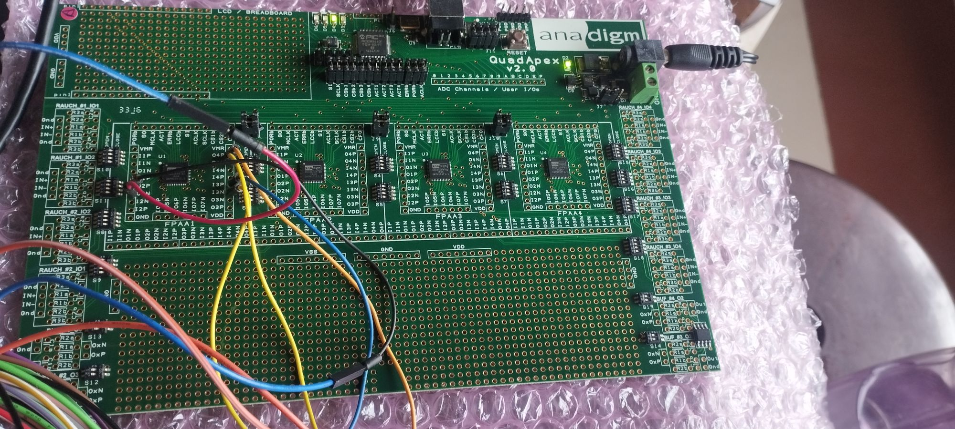
Working of FPAA (AN231E04)
Circuit Design in Anadigm Designer
Parameter Configuration
Simulatiom and Mapping
Upload to Chip
Internal Routing and Realization
Circuit Execution
Fig. FPAA Board

Slide 7
Realization of Analog Circuits using Analog Discovery Kit

Slide 8
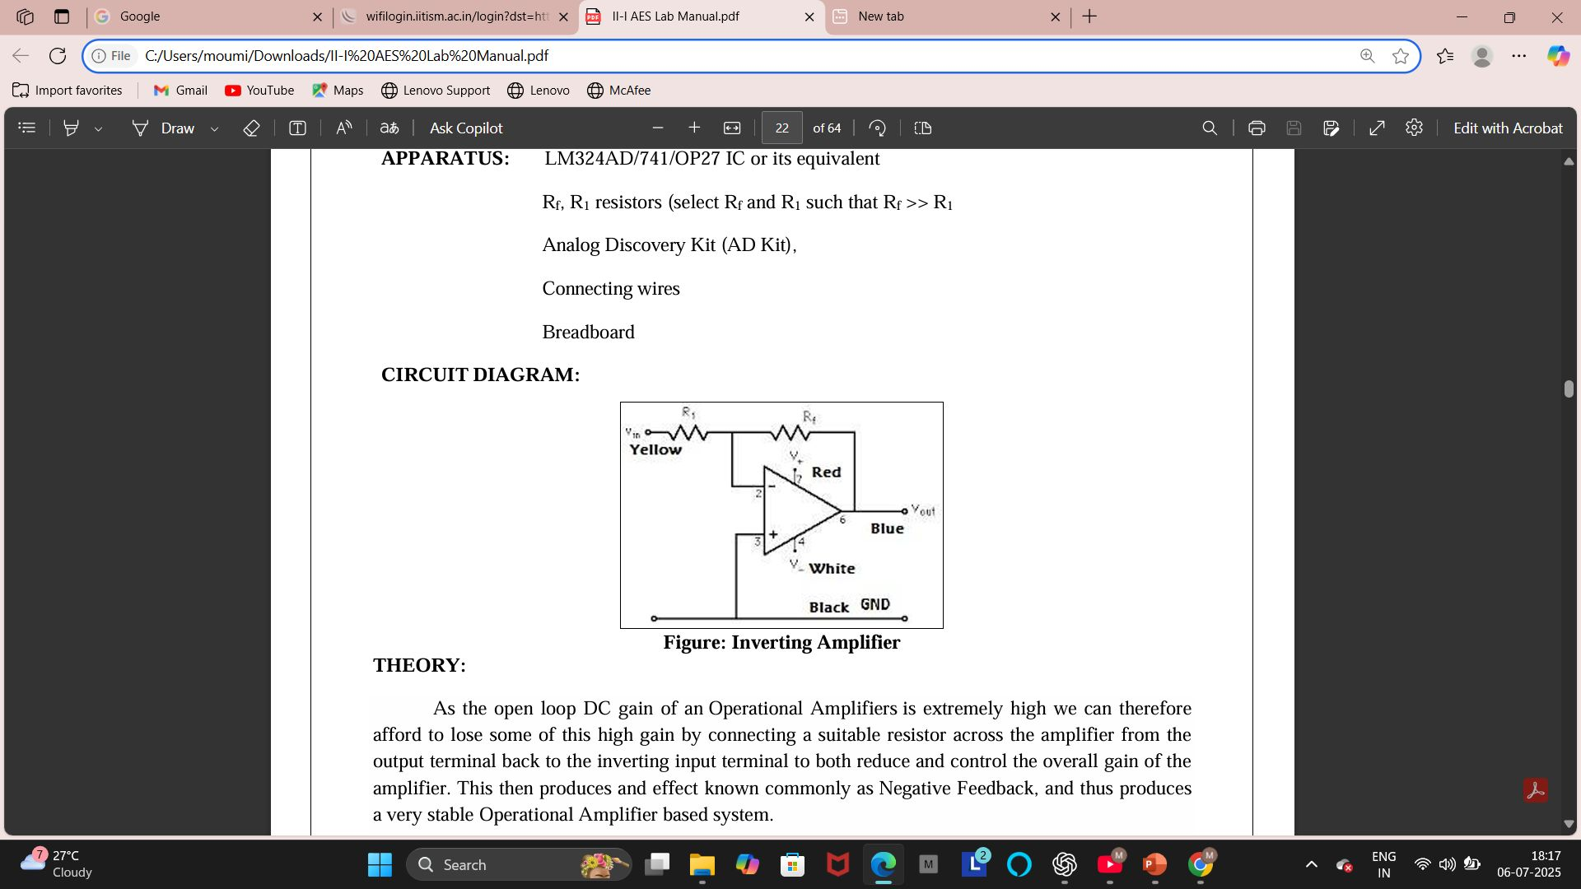
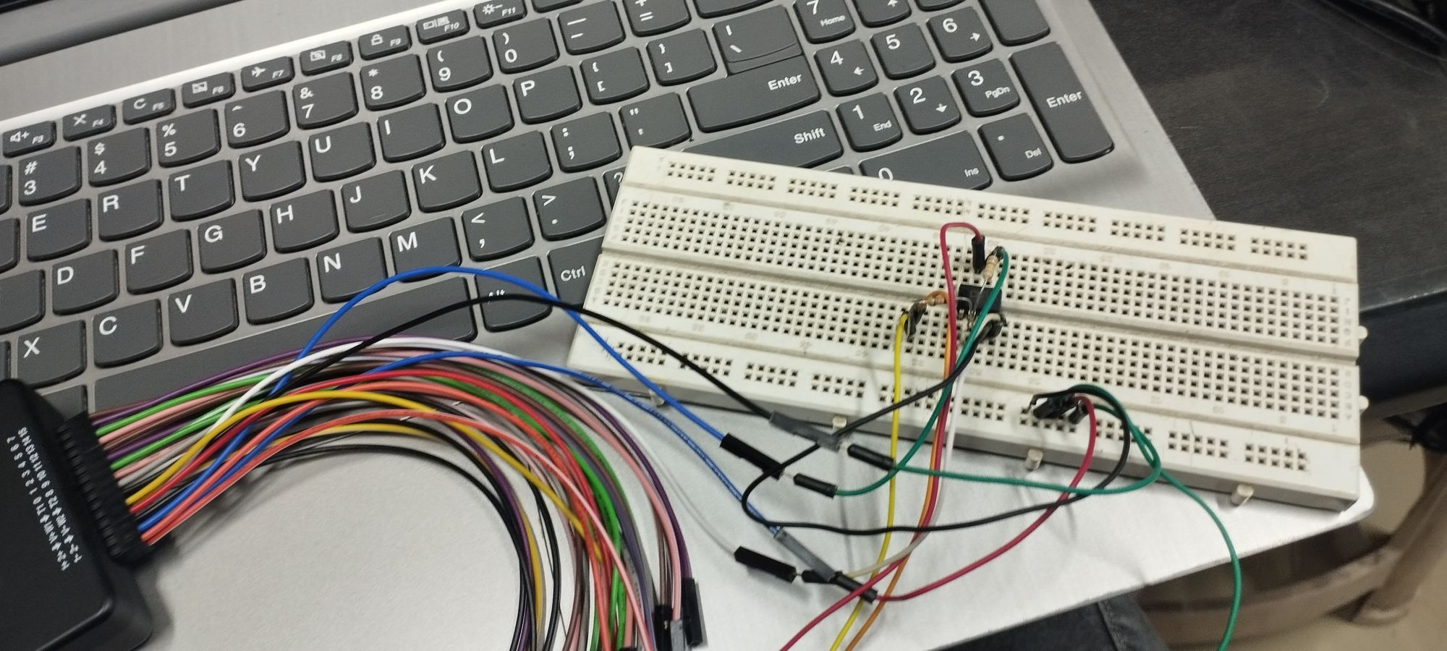
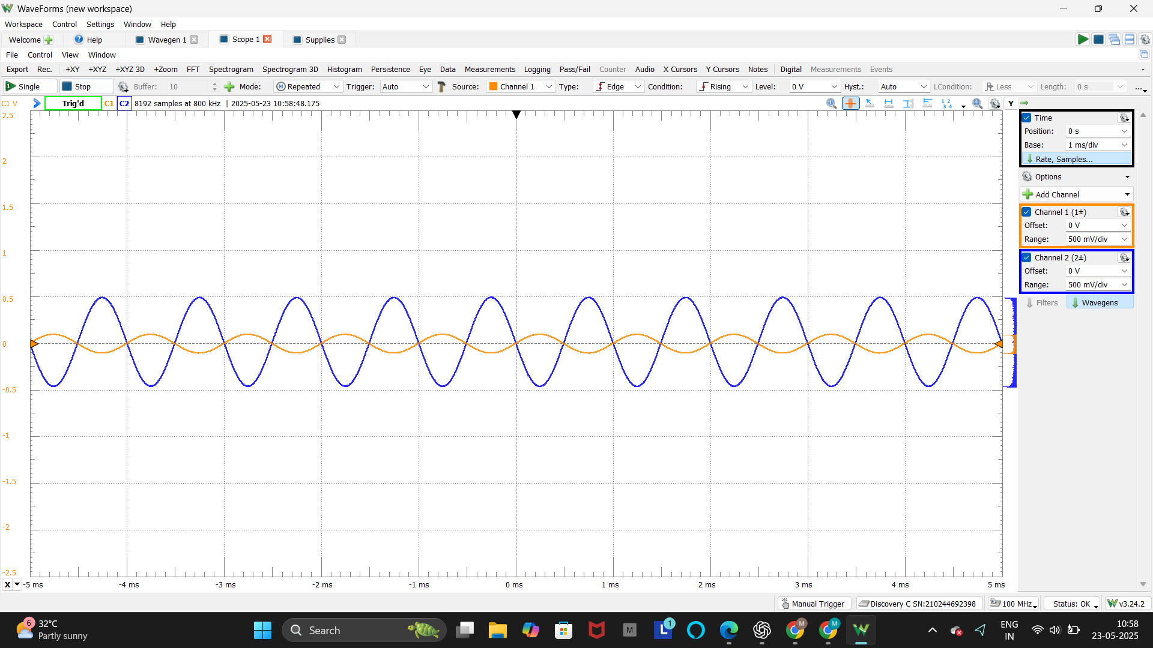
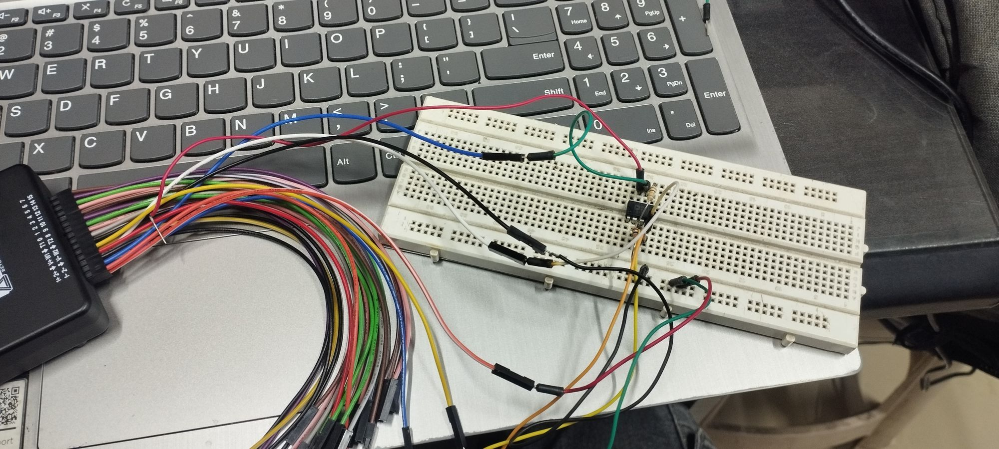
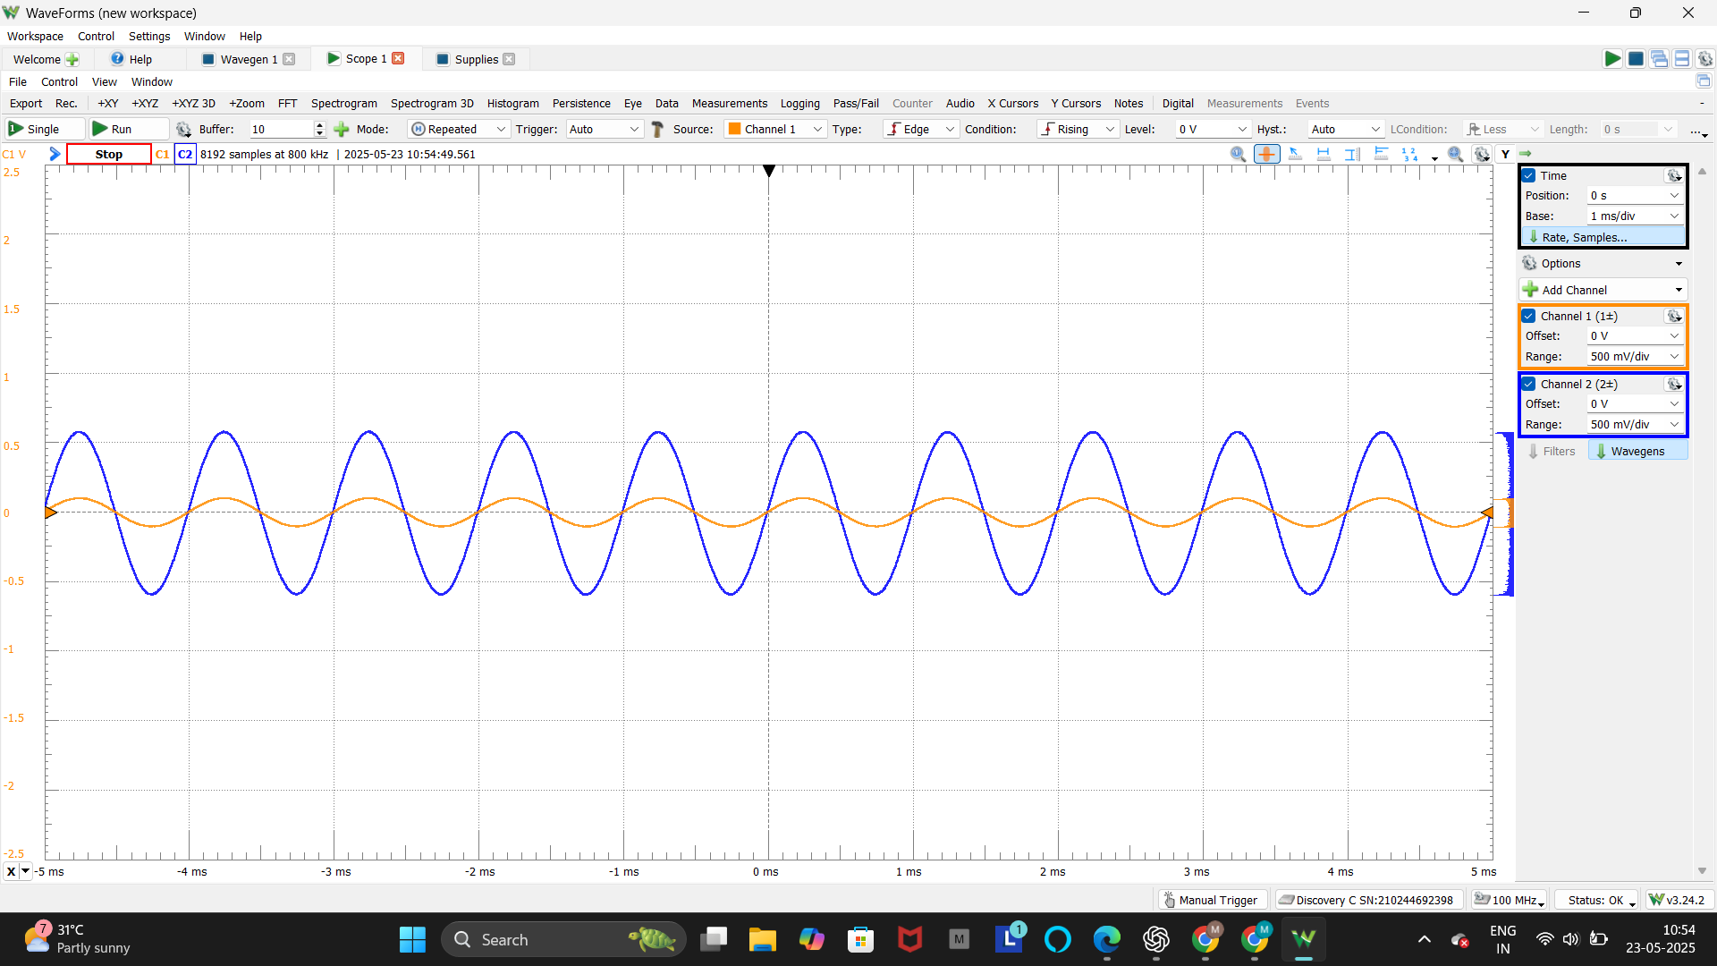
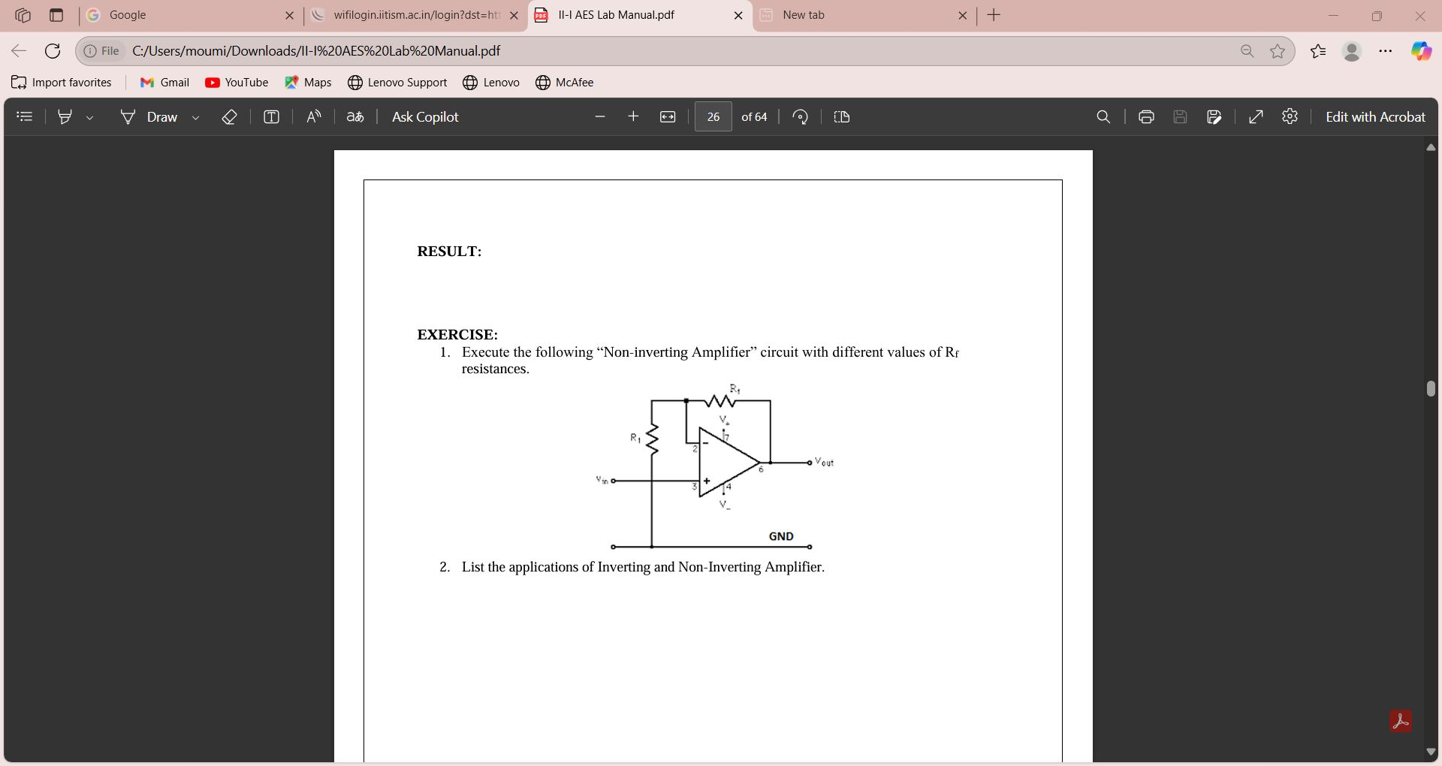
1. Inverting Amplifier.
100 ohm
Input Voltage
1k ohm
Output Voltage
OP27
Input: Sine wave, 1kHz frequency, 2V peak-to-peak.
Output waveform is amplified and inverted (180° phase shift)
2. Non-Inverting Amplifier.
Input: Sine wave, 1kHz frequency, 2V peak-to-peak.
Output waveform is amplified and inverted (180° phase shift)
Input Voltage
1k ohm
Output Voltage
100 ohm
OP27
Input: Sine wave, 1kHz frequency, 2V peak-to-peak. Output is an amplified sine wave in phase with the input.

Slide 9
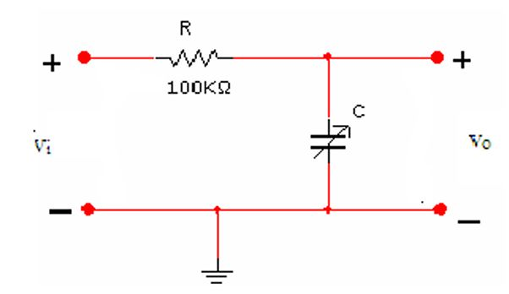
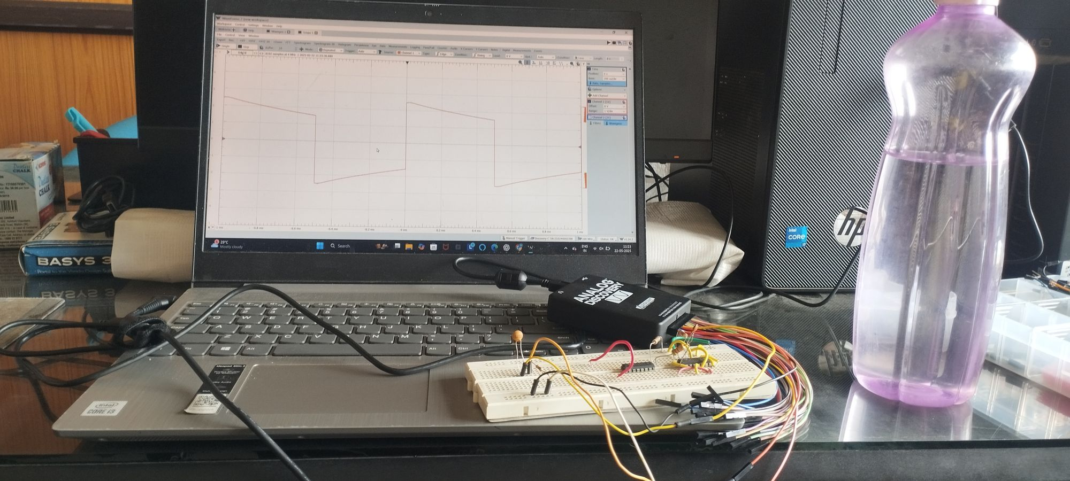
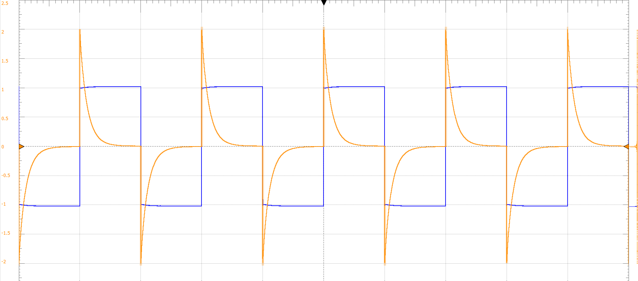
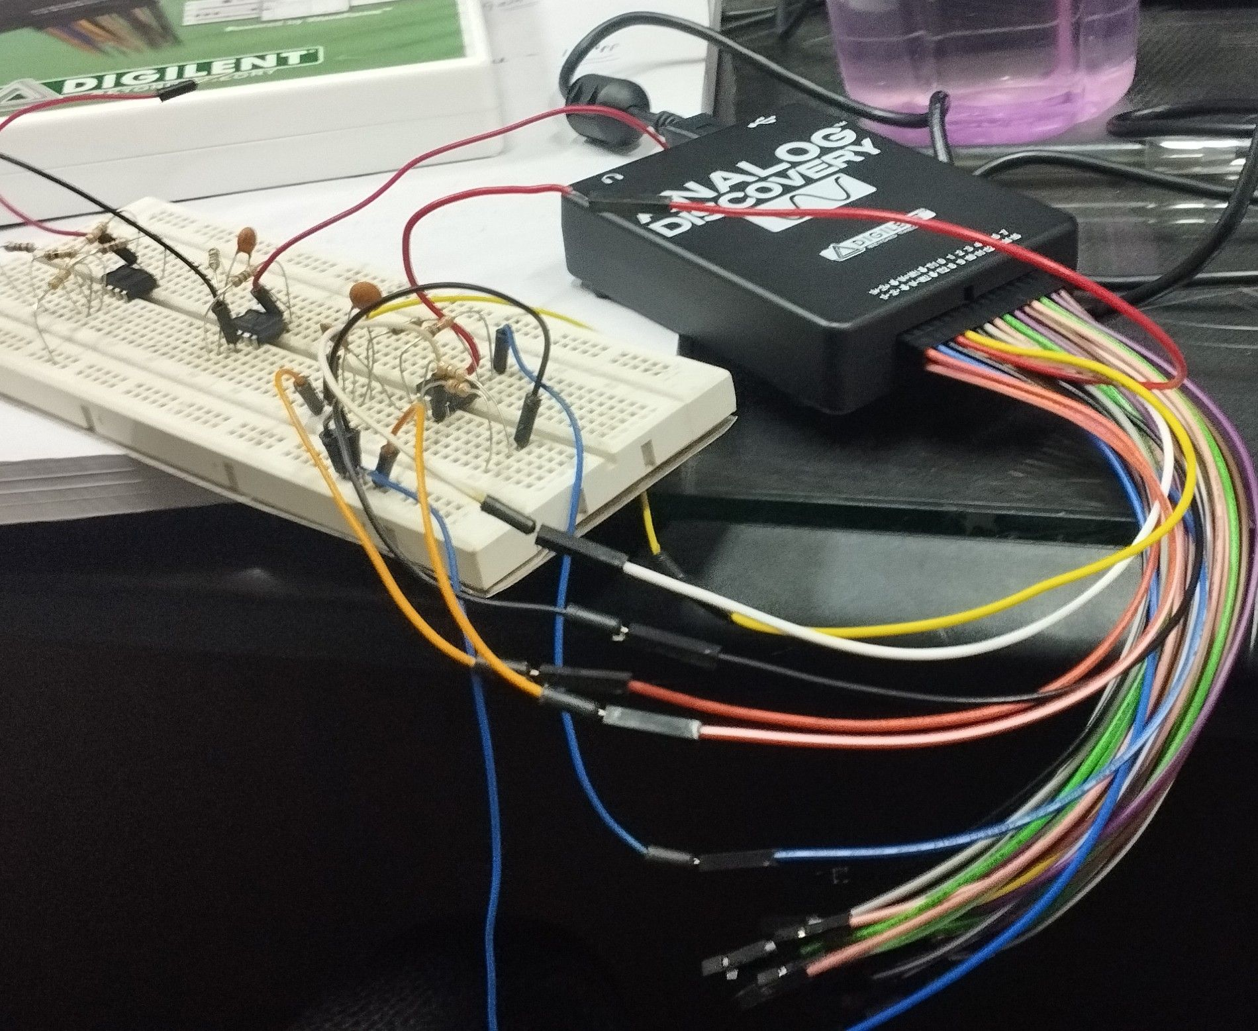
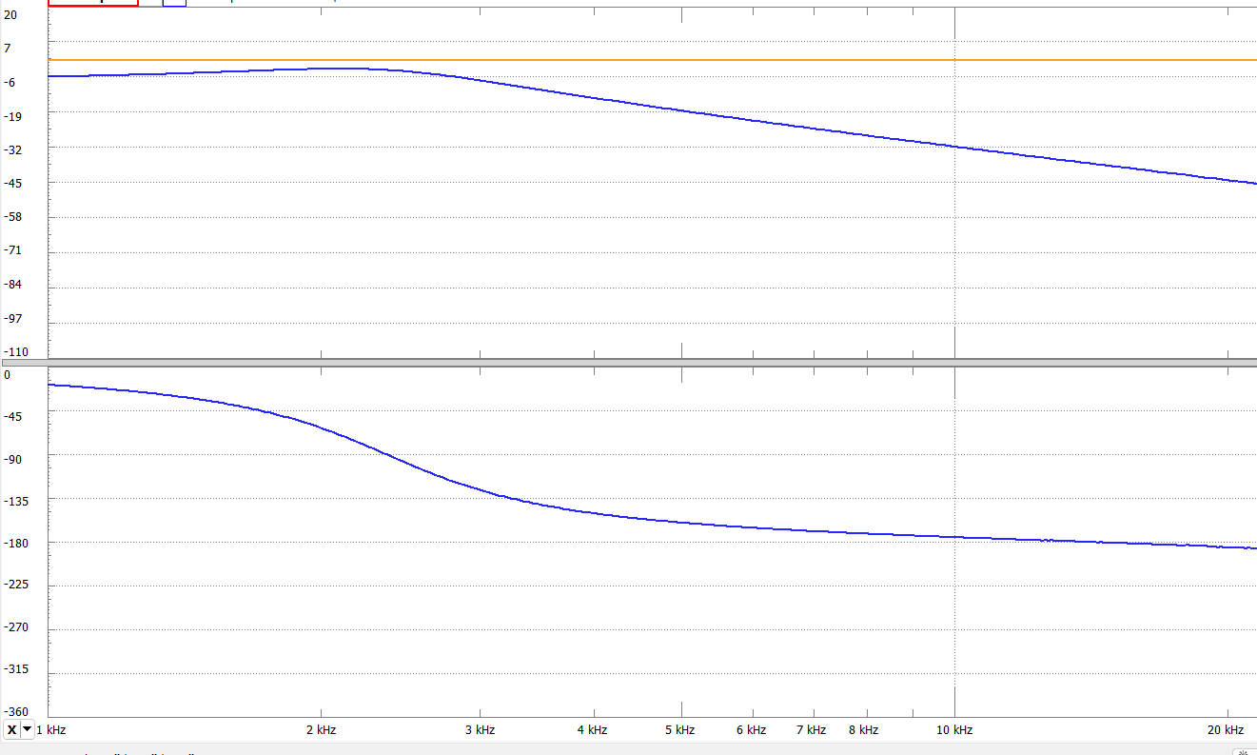
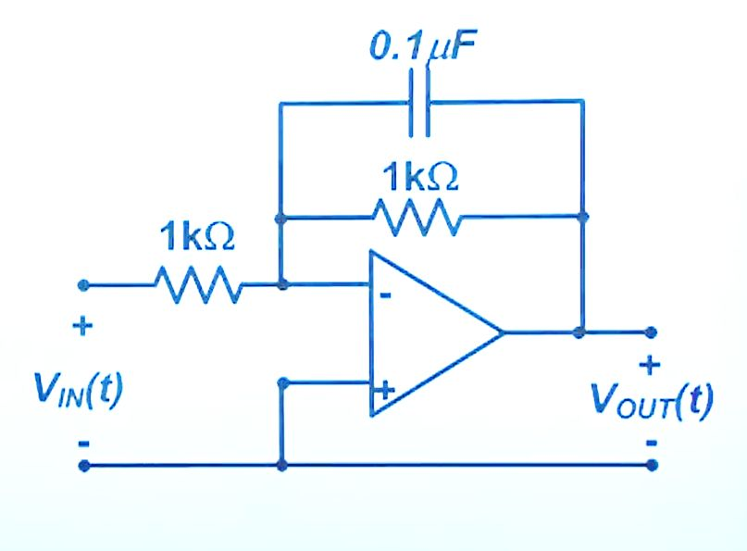
3.Low Pass Filter (Integrator)
Input: 1kHz square wave, 3V peak-to-peak.
Output waveform shows smooth integration—high frequencies are filtered out.
4. Frequency and Phase Response
Input: Sine wave, 1kHz frequency, 2V peak-to-peak.
Output waveform is amplified and inverted (180° phase shift)
Magnitude
In dB
phase
OP27
In
degree
Input : Frequency sweep(1Hz-100kHz).
Frequency and phase response of circuits is analyzed using Waveforms Bode plot.

Slide 10
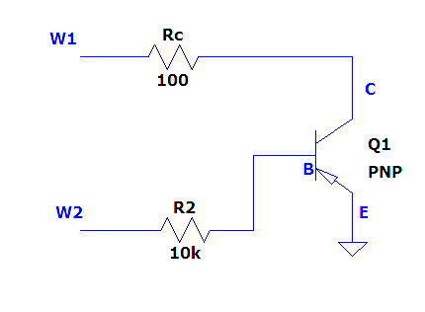
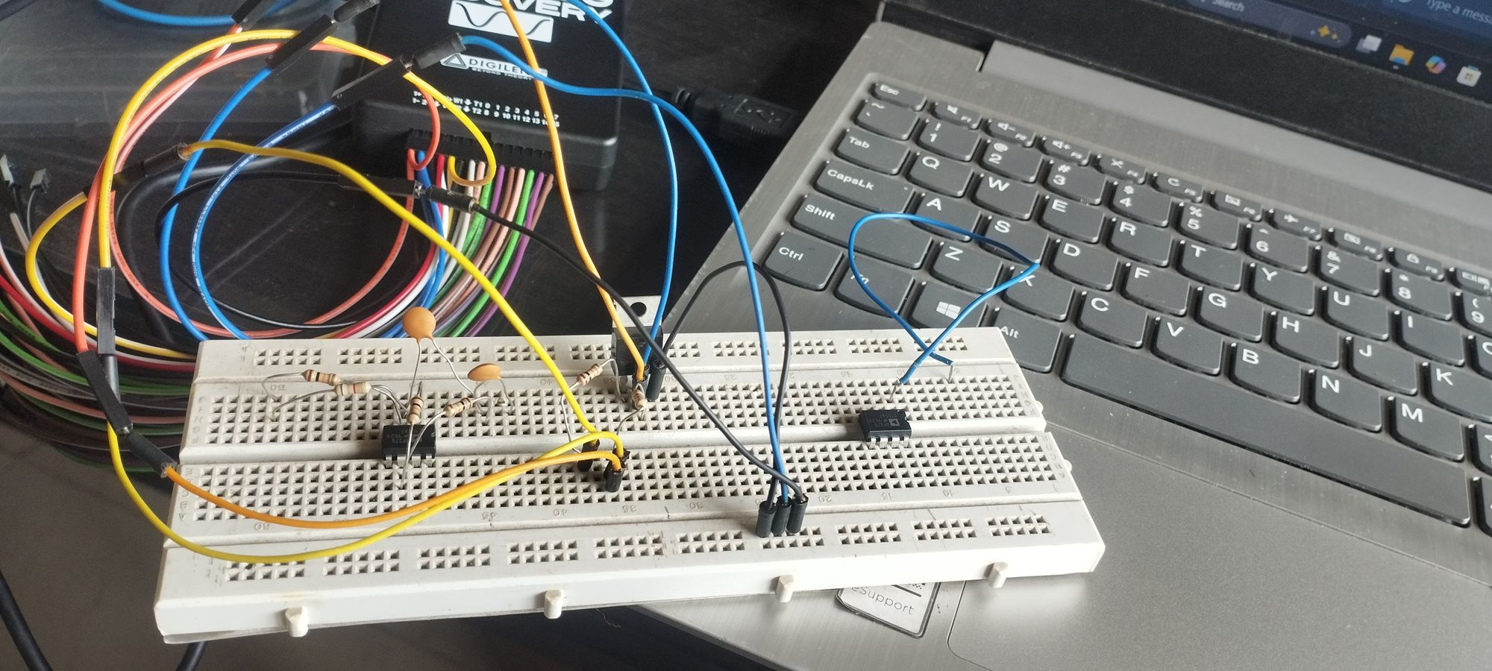
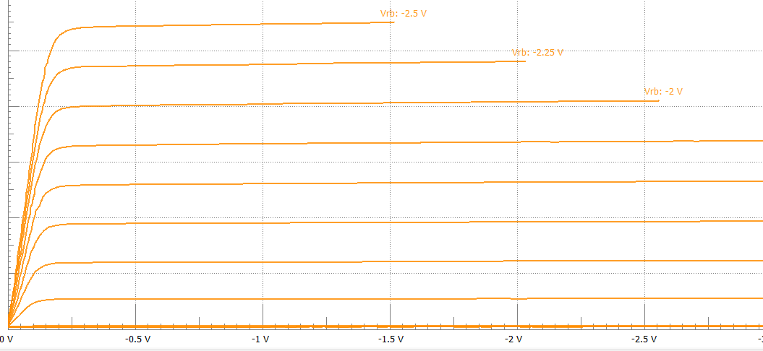
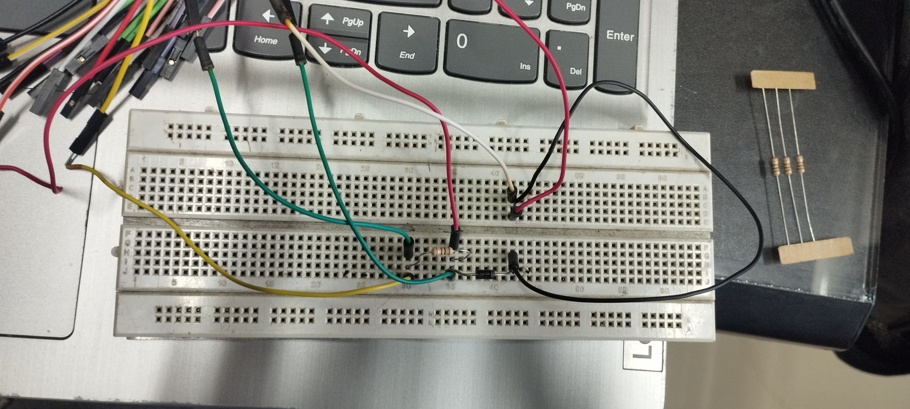
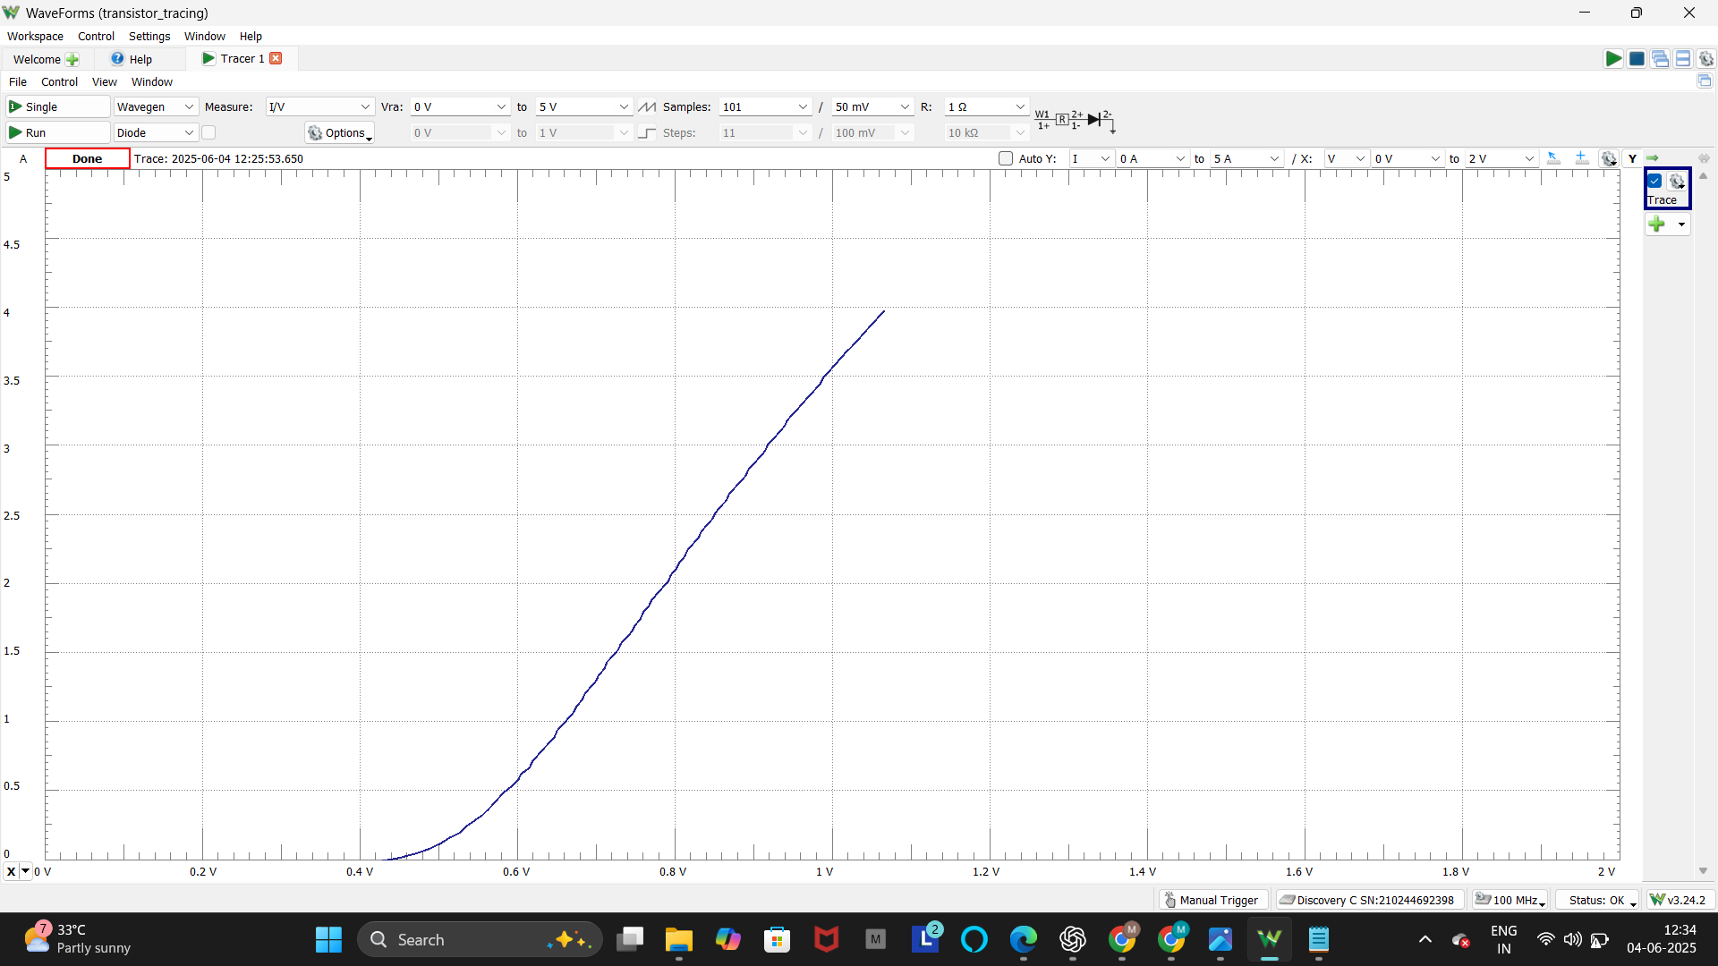
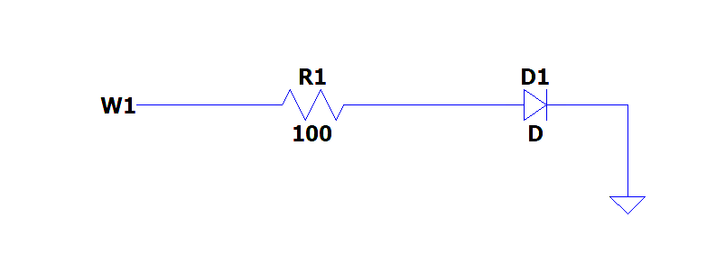
5. PNP Transistor Characteristics (using Curve Tracer)
Ic
TIP31C
Vbc
Input: DC voltage sweep applied across the transistor terminals with varying base current.
The characteristic curves display the transistor’s active, cutoff, and saturation regions.
4. Diode Characteristics (using Curve Tracer)
Input: Sine wave, 1kHz frequency, 2V peak-to-peak.
Output waveform is amplified and inverted (180° phase shift)
1n4007
I
Input :Triangular voltage sweep across the diode terminals.
The diode conducts current in forward bias after the threshold voltage and blocks current in reverse bias, forming the typical I-V curve.
Voltage

Slide 11
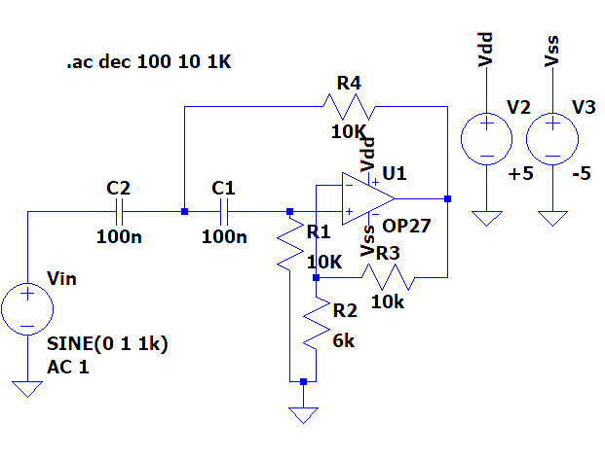
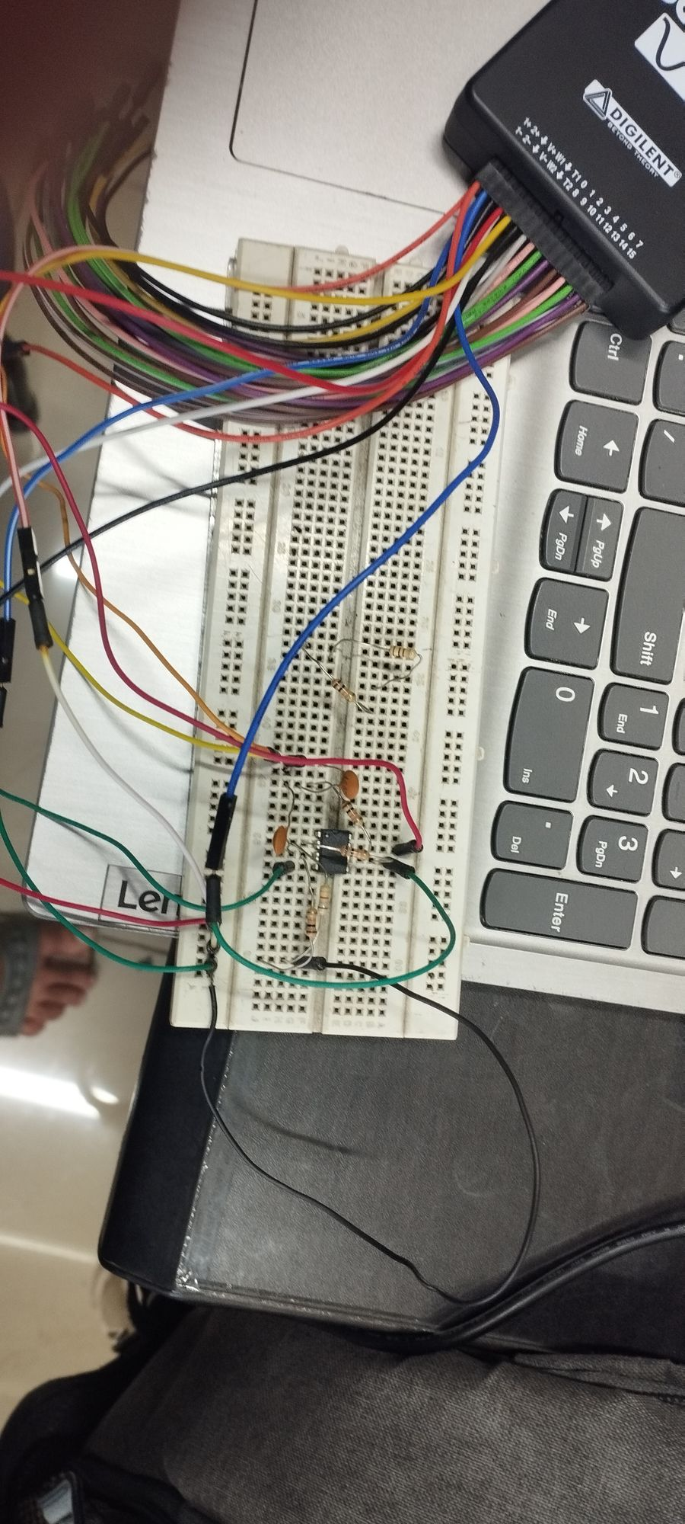
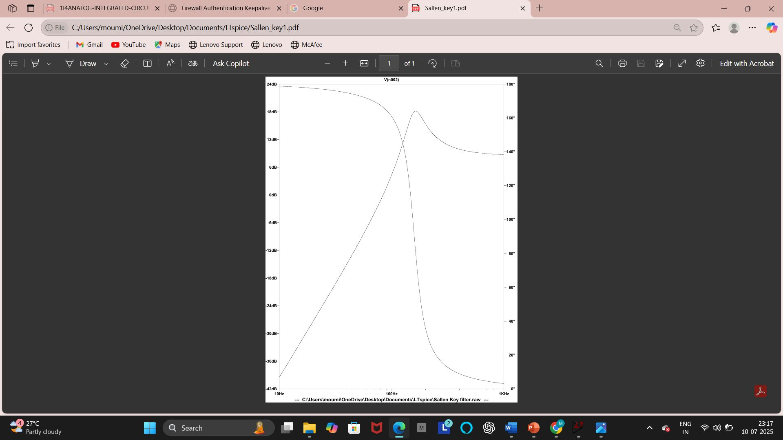
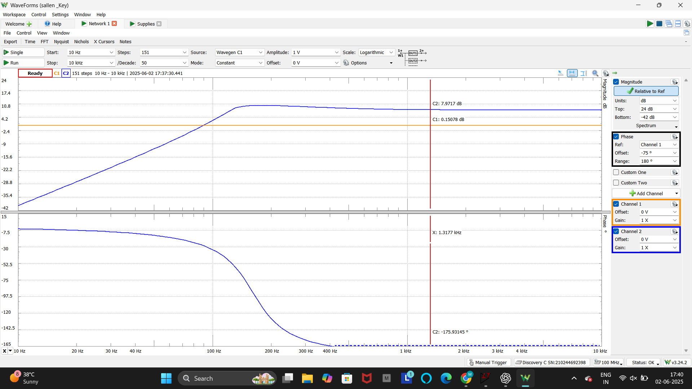
5.Sallen-Key Filter
Input: Sine wave, 1kHz frequency, 2V peak-to-peak.
Output waveform is amplified and inverted (180° phase shift)
Objective: To design and implement a 2nd-order low-pass filter using the Sallen-Key topology.
Circuit: The circuit consists of two resistors and two capacitors with an operational amplifier (Op-Amp) configured for low-pass filtering.
Working Principle: The Sallen-Key filter attenuates high-frequency signals while allowing low-frequency signals to pass through. It uses switched-capacitor behavior and RC components to define the cutoff frequency.
Result: The Bode plot shows the expected frequency response: ✔ Flat response at low frequencies ✔ Smooth roll-off beyond the cutoff frequency.
In
dB
In
degree
Fig :Output Waveform comparision of LT spice software and analog Discovery kit

Slide 12
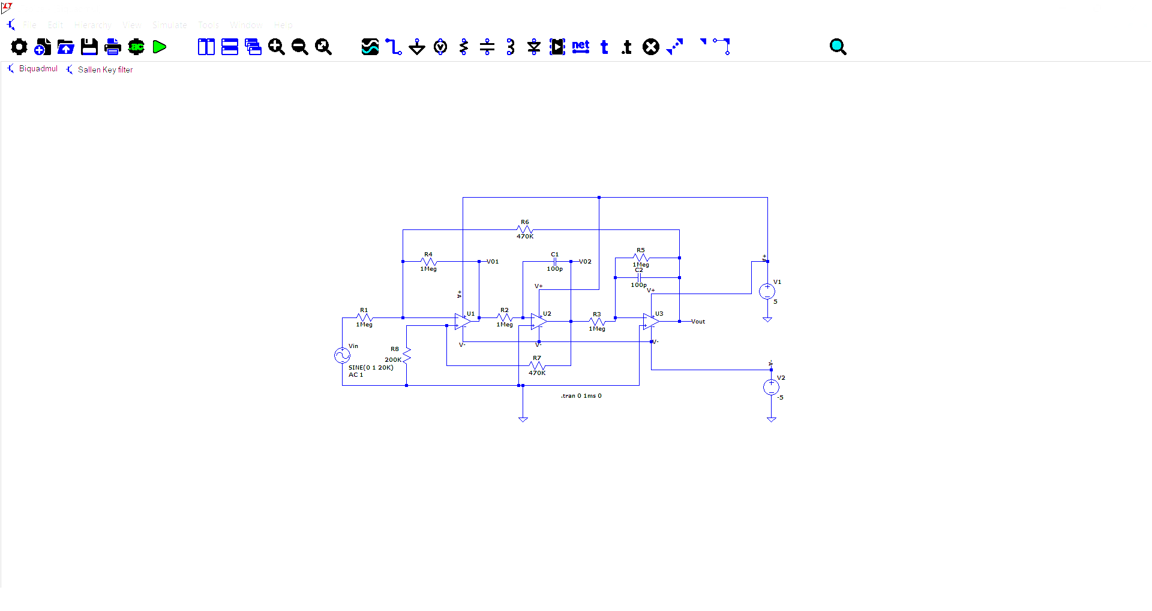
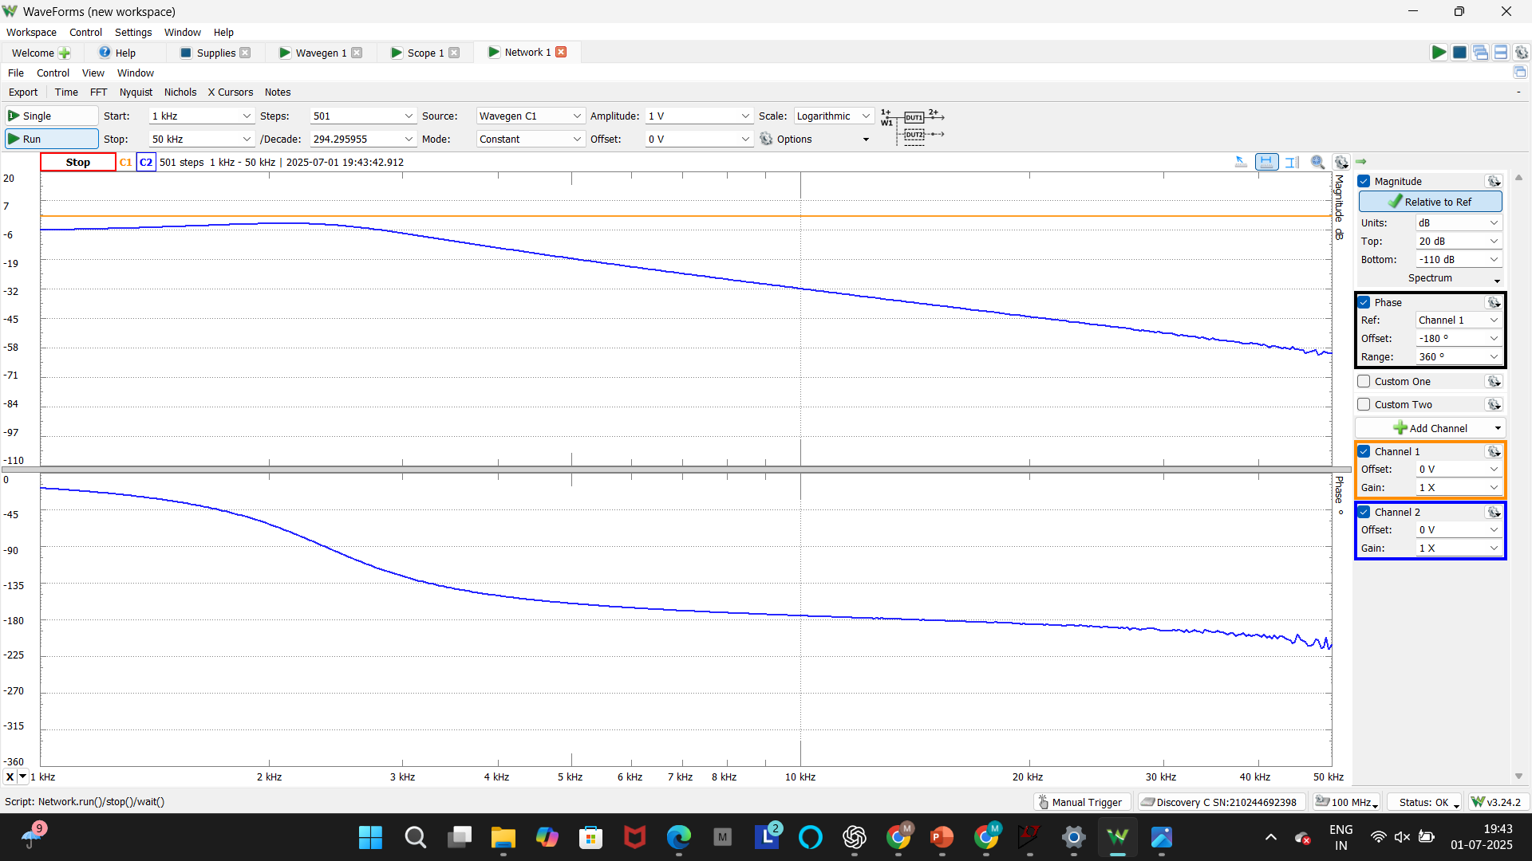
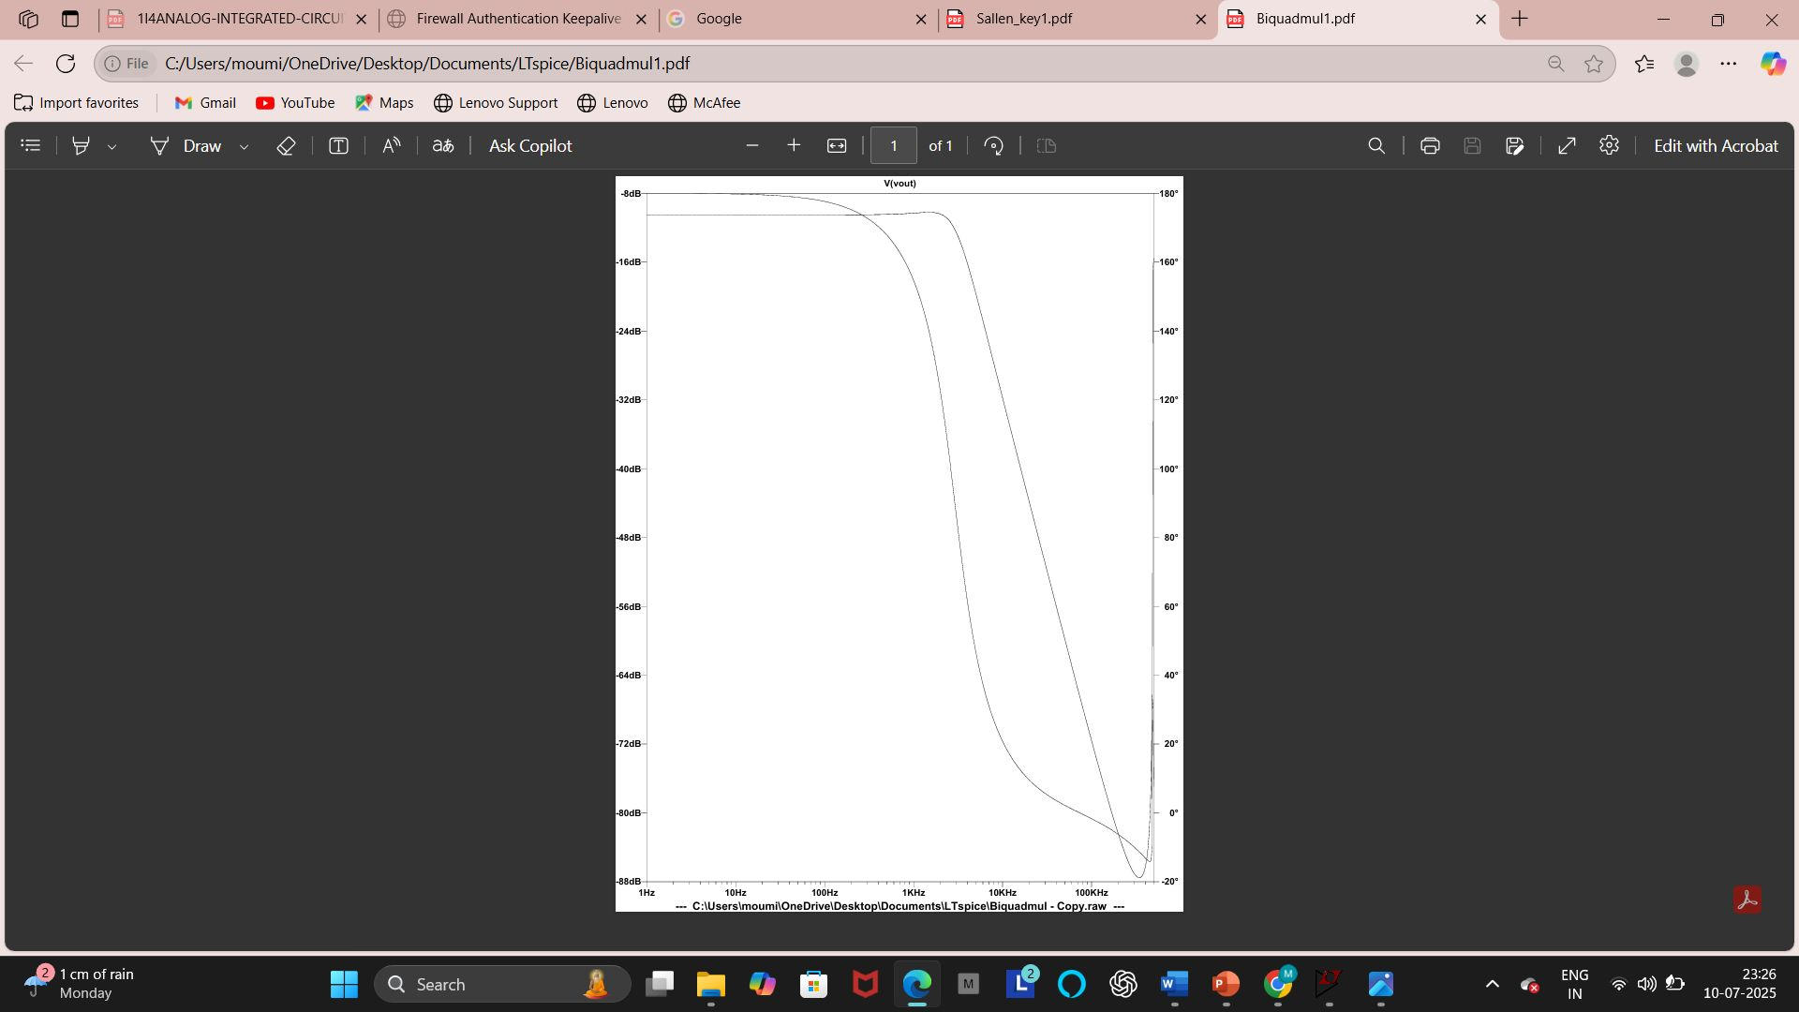
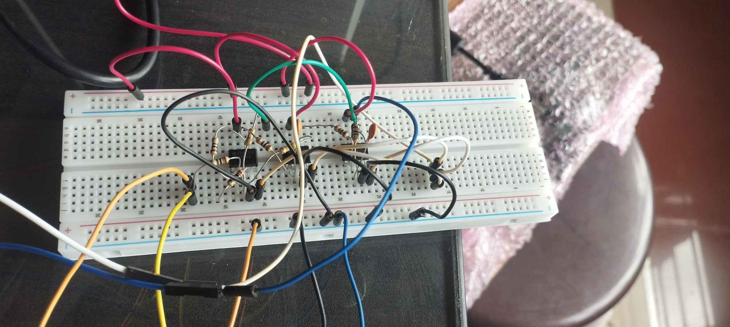
5.Biquadratic Filter
12
hg
The Biquadratic (Biquad) Filter is a second-order active filter offering sharper frequency selectivity than basic RC filters.
The name "biquadratic" comes from the squared term in the transfer function, which allows precise control over frequency response.
The filter can be configured as low-pass, high-pass, band-pass, notch, or all-pass depending on circuit arrangement.
It is widely used in audio processing, communication systems, and digital signal processing.
The cutoff frequency of the circuit is approximately 1.8 kHz, indicating low-pass filter behavior.
In dB
In
degree
Fig :Output Waveform comparision of LT spice software and analog Discovery kit

Slide 13
Realization of Analog Circuits using FPAA

Slide 14
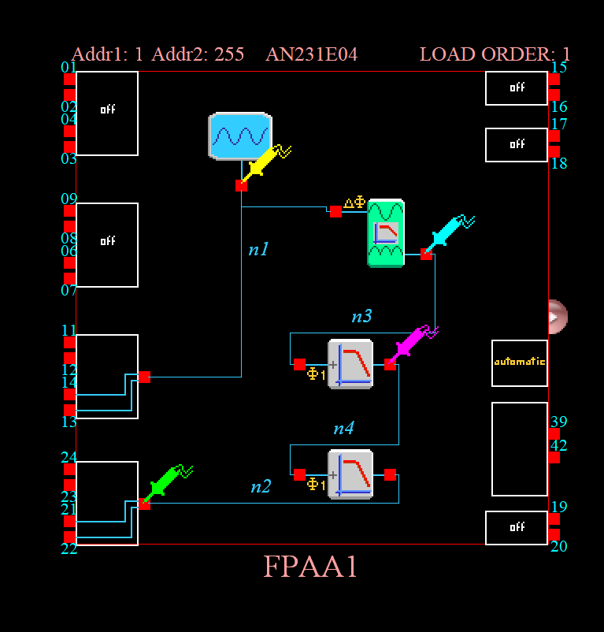
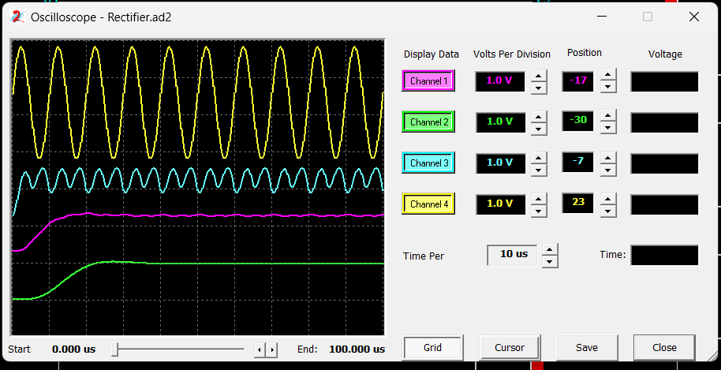
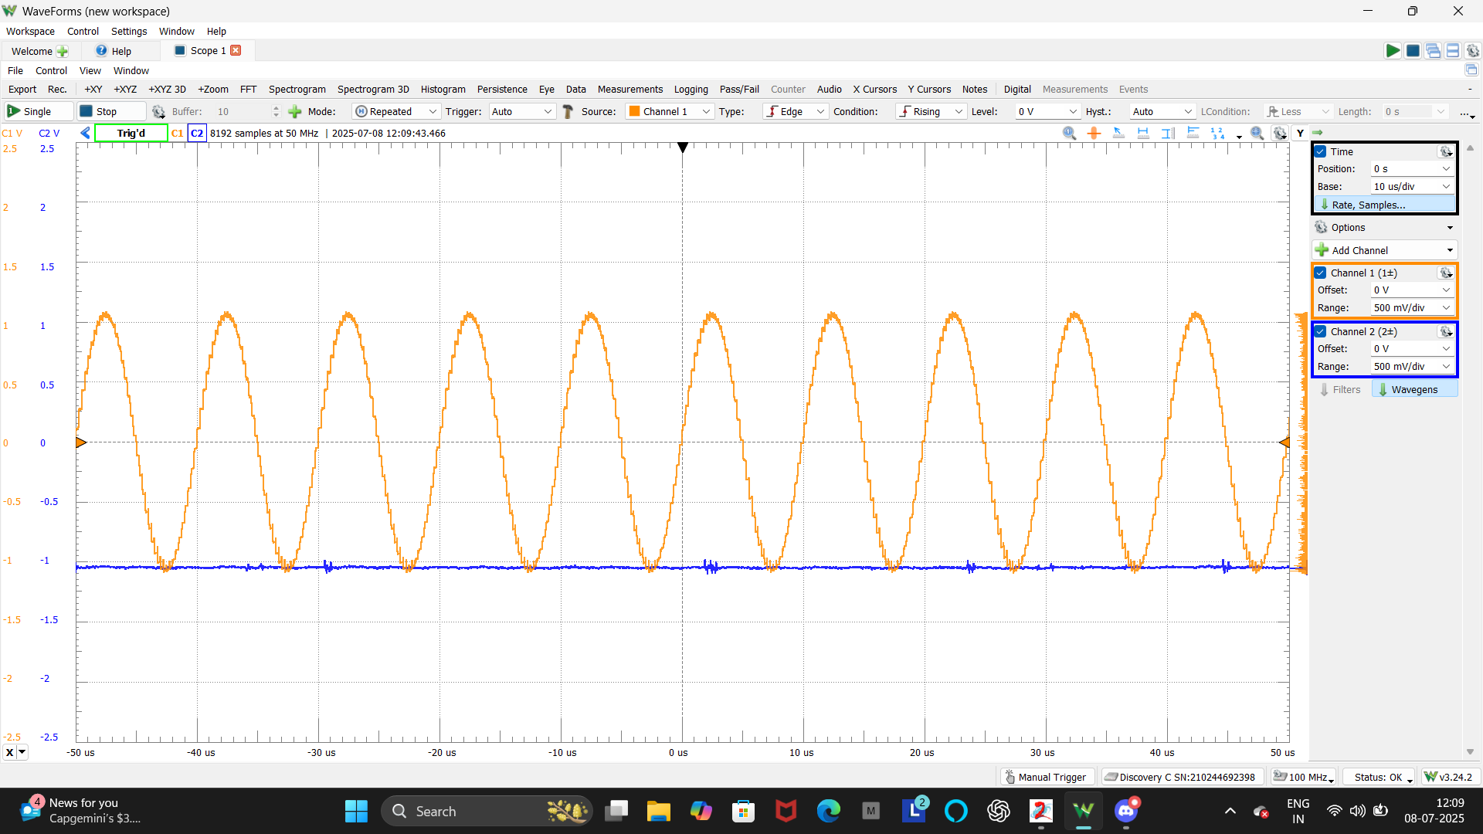
Full Wave Rectifier
Oscillator Sine CAM
Objective: To design and implement a full-wave rectifier circuit using theFPAA kit.
Circuit:
Oscillator generates AC input, rectifier processes the signal, and filters smooth the output.
Working Principle:
Converts an AC input signal into a DC-like waveform by inverting the negative half-cycles.
Low-pass filters reduce ripple and smooth the rectified
output.
Implementation:
The circuit was designed using AnadigmDesigner2 and successfully implemented on the FPAA (AN231E04) kit. The output was verified using the Analog Discovery Scope.
Rectifier Filter CAM
Biquad
Low-Pass
CAM
Notes:
This slide presents the Full-Wave Rectifier circuit designed and implemented using the FPAA. The rectifier’s job is to convert an AC signal into a unidirectional waveform by inverting the negative half-cycles. I have designed the circuit using Oscillator sine ,Rectifier filter,and Biquad low pass filter in AnadigmDesigner2 and downloaded it into the FPAA chip. the output showed a clear full-wave rectification on the oscilloscope. This kind of circuit is fundamental in power supply design and AC to DC conversion systems.”

Slide 15
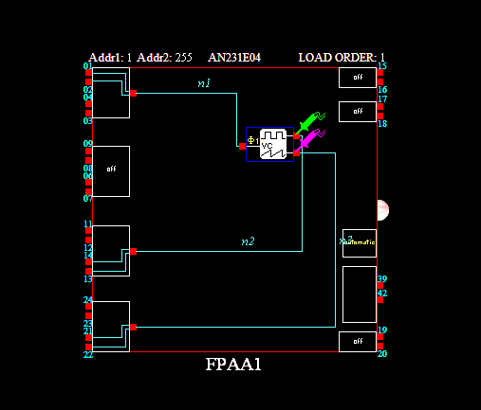
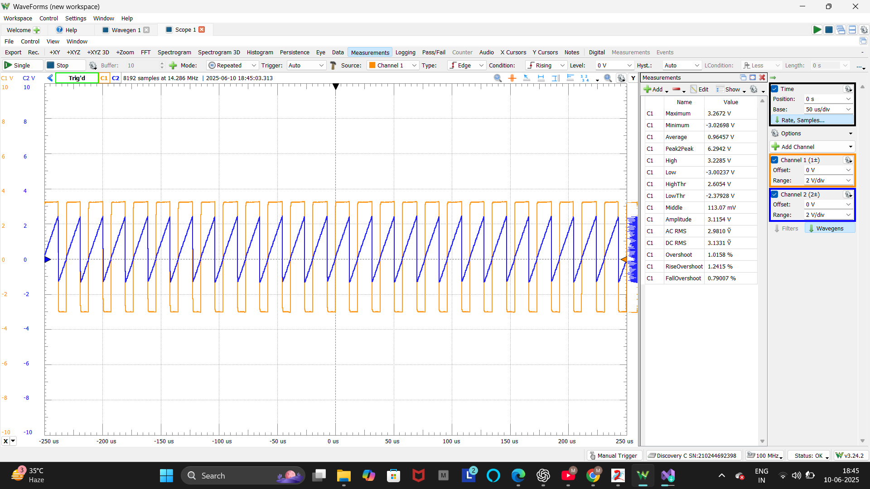
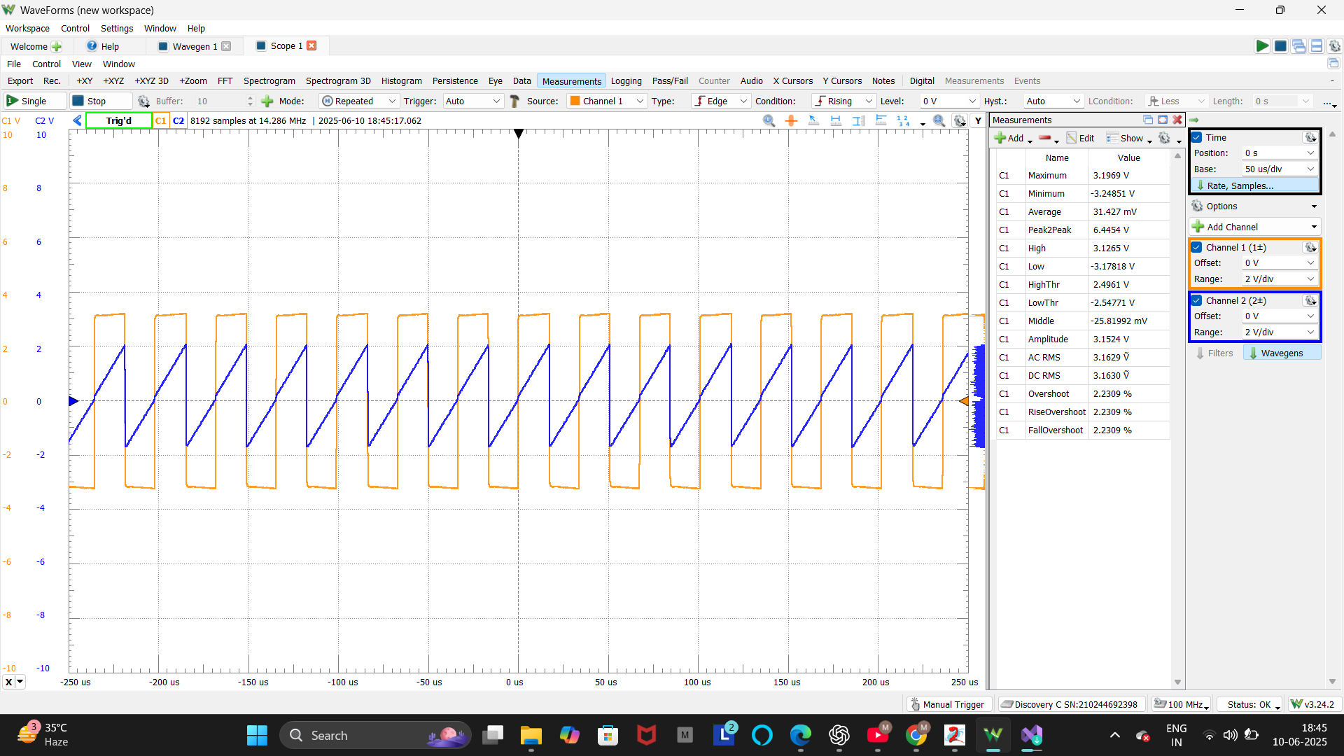
VCO (Voltage Controlled Oscillator)
VCO CAM
Objective: To design and implement a Voltage-Controlled Oscillator (VCO) circuit using the FPAA (AN231E04) kit.
Circuit: • Two different DC input voltages were provided externally using the Analog Discovery to control the oscillation frequency.
Working Principle: • The output frequency changes based on the applied input voltage. • As the input control voltage increases, the oscillation frequency increases proportionally. • The FPAA dynamically adjusts the waveform through its internal programmable analog blocks.
Result: • Two different output waveforms were obtained for two different input voltages. • Higher input voltage produced higher frequency oscillation.
Notes:
“This slide shows the Voltage Controlled Oscillator (VCO) implemented using FPAA. The VCO is a circuit where the output frequency changes according to the applied voltage. It uses an Integrator and Comparator to generate square wave output. We designed the circuit using AnadigmDesigner2, implemented it on the FPAA board, and tested it with the Analog Discovery Kit. As we varied the input voltage, we observed corresponding changes in the frequency of the waveform, confirming the correct operation of the VCO. This type of circuit is widely used in FM modulation, PLL circuits, and signal generators.”

Slide 16
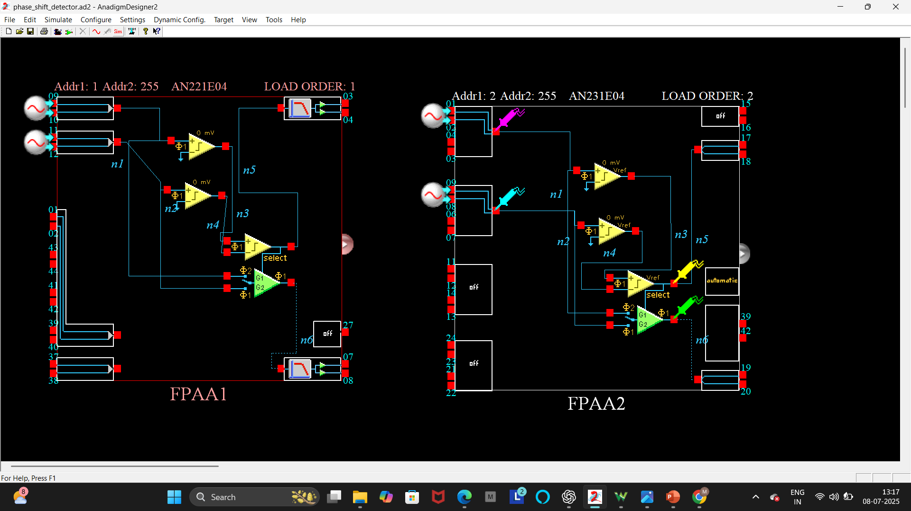
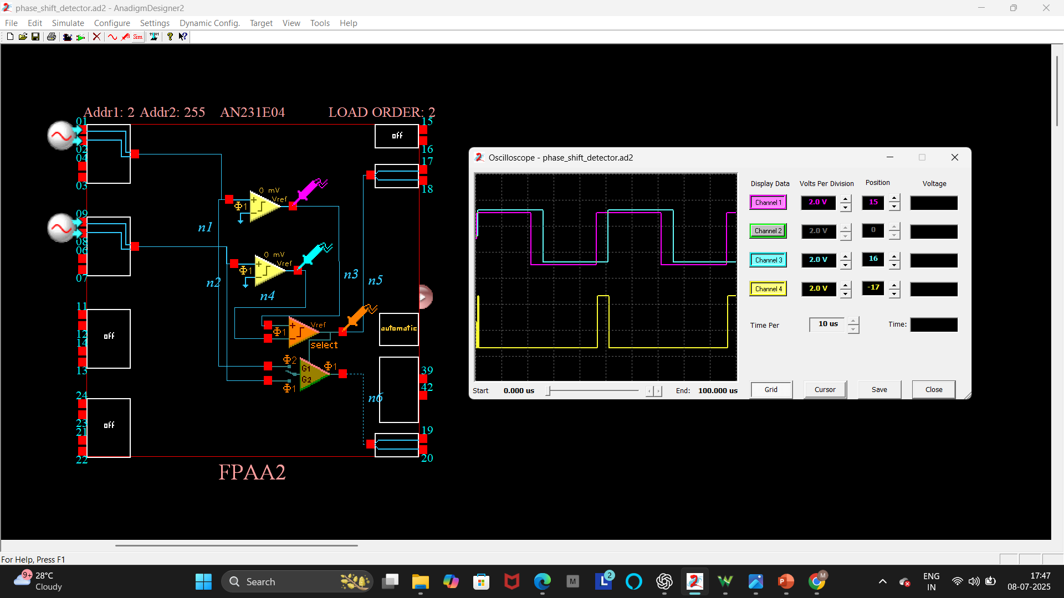
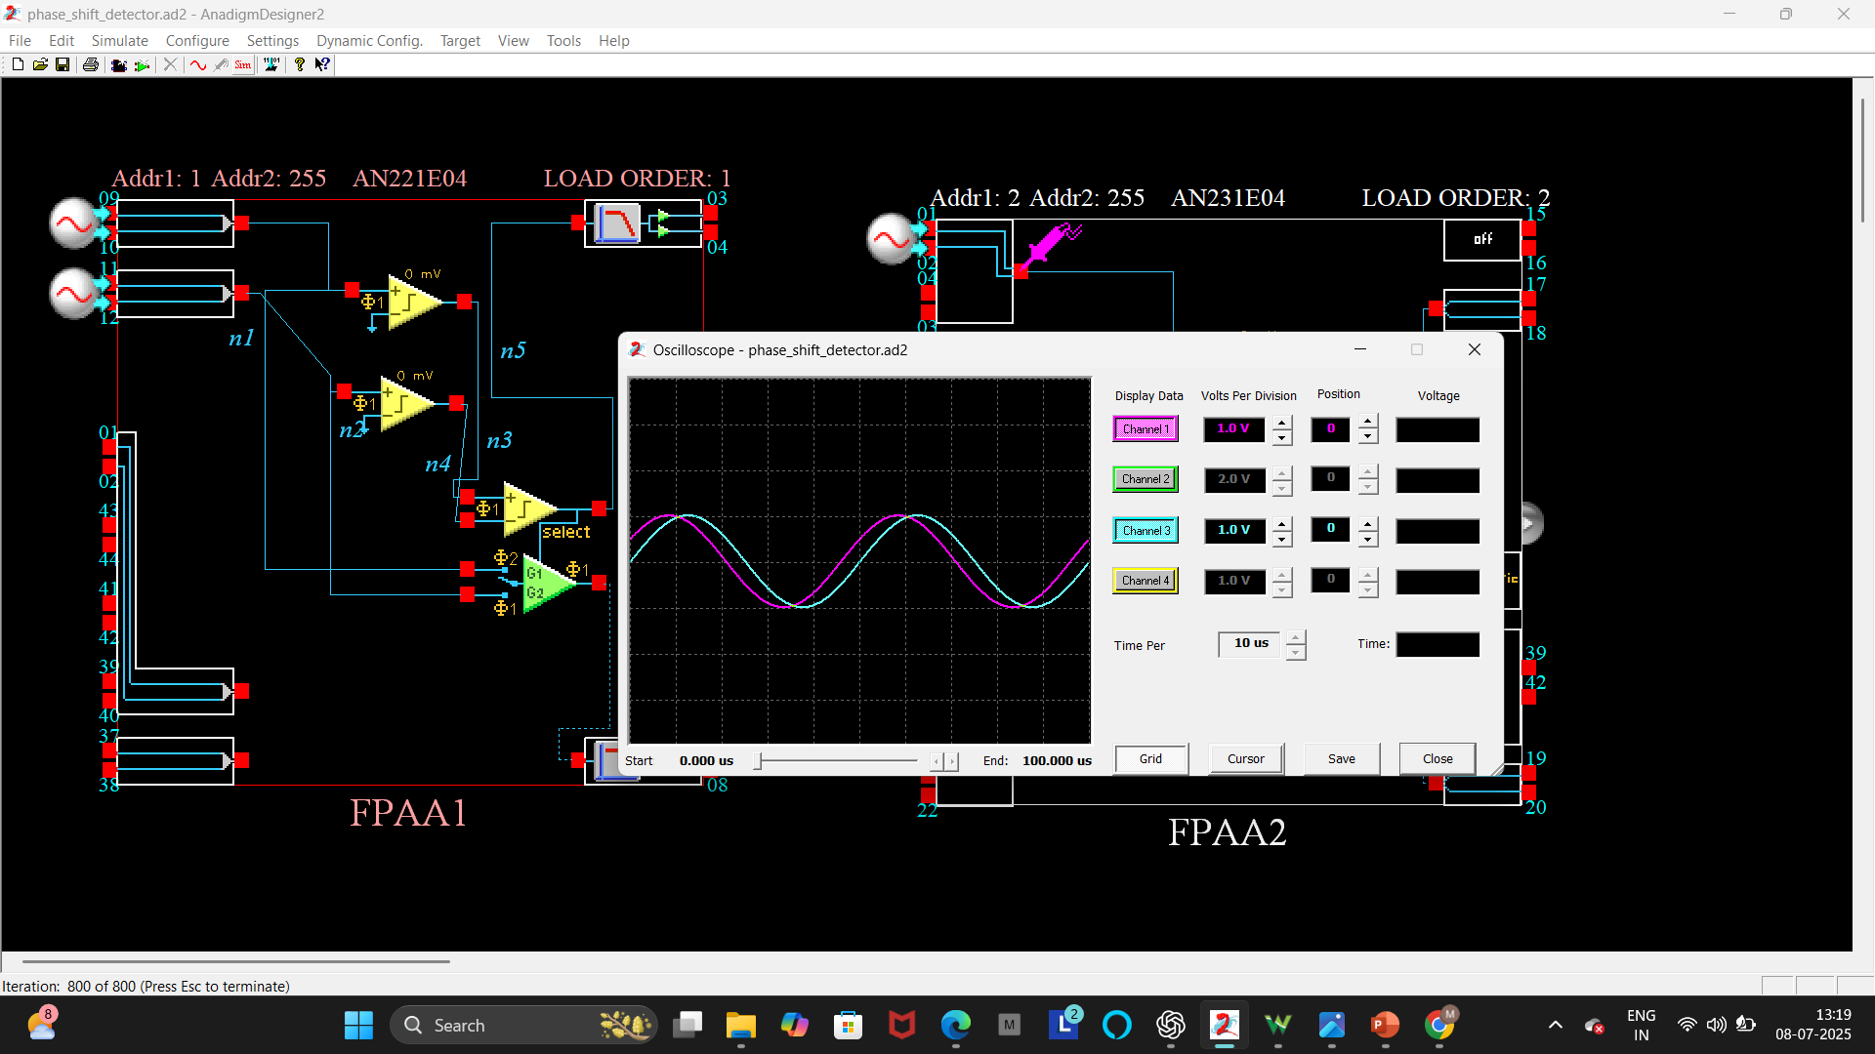
Phase Shift Detector
Objective: To design and simulate a Phase Shift Detector circuit using the FPAA (AN231E04) to identify phase difference between two input signals.
Working Principle: The circuit compares two sine wave inputs. • If a phase difference is detected, the comparators generate outputs that lead to a Pass/Fail decision. • This allows real-time identification of phase shift between the signals.
Result: Simulation results show two sine waves: one reference (fault-free) and one with a phase difference (faulty).. • The system generates a Pass/Fail signal confirming detection of the
phase difference.
Comparator
CAM
Gain Stage with Switchable inputs CAM
First Comparator output C1
The Fault Free input
Second Comparator Output C2
Pass/Fail Signal
The Faulty Input
Notes:
“This slide shows the Phase Shift Detector circuit designed using the FPAA. The goal was to identify any phase difference between two input sine waves—one as reference, and one as a test signal. Using Comparator CAMs, the sine waves are converted to square waves and compared for alignment. In simulation, when a phase difference is present, the circuit triggers a Pass/Fail signal to indicate detection. This concept is useful in applications like power fault monitoring and industrial control systems.

Slide 17
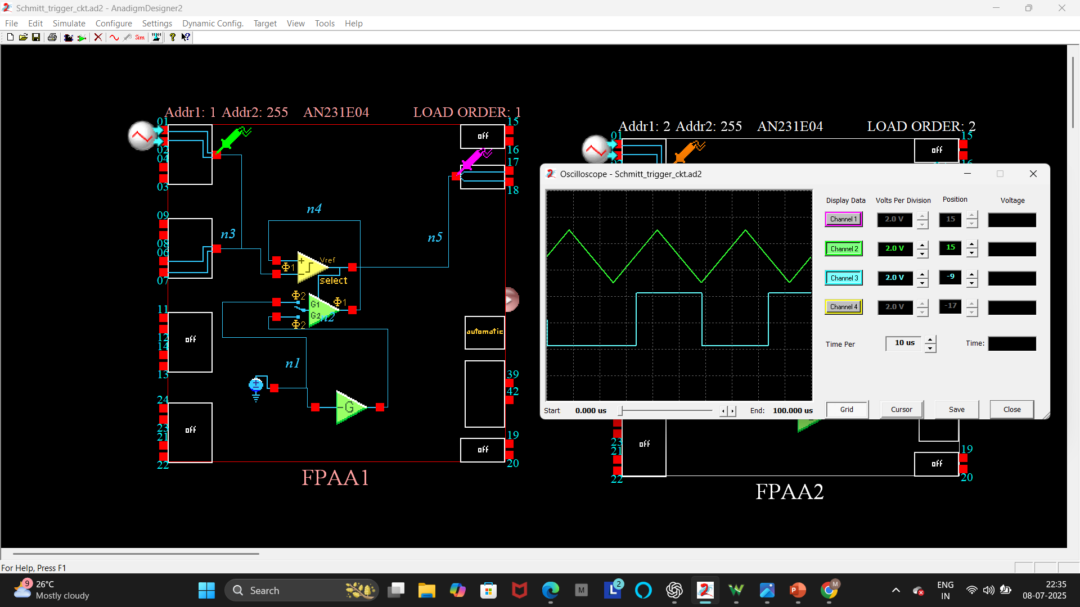
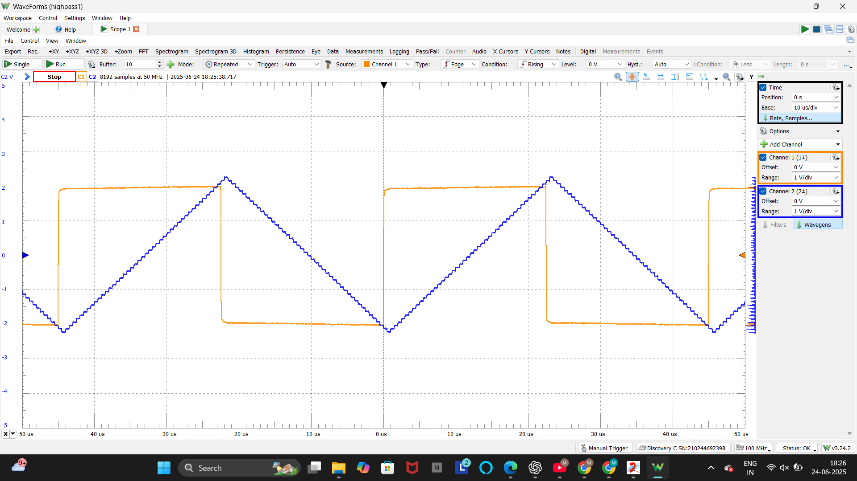
Schmitt Trigger Circuit
Objective: To design and simulate a Schmitt Trigger circuit using the FPAA (AN231E04) for signal conditioning and noise immunity.
Working Principle: The Schmitt Trigger is a comparator with hysteresis. • It switches its output high or low when the input crosses specific threshold voltages. • This ensures clean transitions by rejecting small fluctuations or noise around the threshold. • The hysteresis (difference between upper and lower thresholds) provides stability.
• Implements positive feedback to achieve hysteresis, which is
essential for Schmitt Trigger behavior.
Result: • The simulation output confirms proper Schmitt Trigger behavior with clear, noise-free switching.
Gain Stage with Switchable inputs CAM
DC Voltage
Source CAM
Inverting Gain
Stage CAM
Notes:
“In this slide, I’m presenting the Schmitt Trigger circuit designed and simulated using the FPAA. A Schmitt Trigger is essentially a comparator with hysteresis, which means it switches output states only when the input crosses well-defined upper or lower thresholds. This prevents false triggering due to noise and provides clean transitions. The circuit was simulated using AnadigmDesigner2, and the results showed stable, noise-immune switching, which is key for applications like, waveform shaping, and noise filtering.”

Slide 18
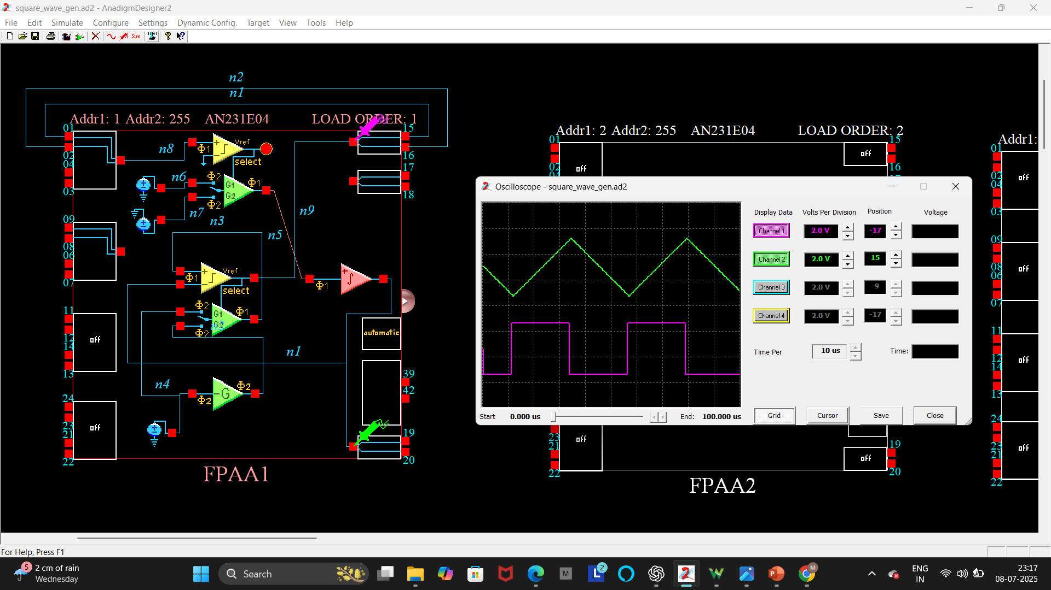
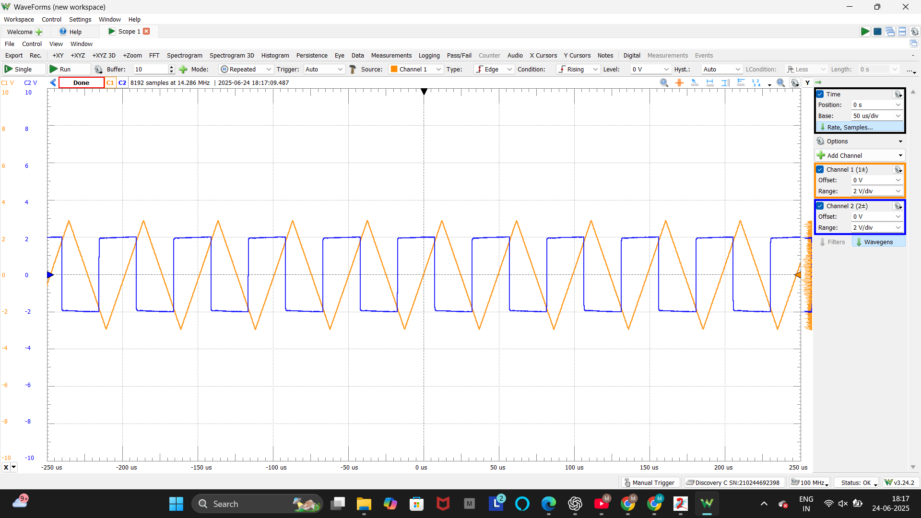
Square wave Generator
Comparator
Block
Objective: To design and implement a square wave generator with programmable frequency and duty cycle using the FPAA (AN231E04).
Circuits:
• The circuit combines a Schmitt Trigger and an Integrator to
produce square wave and triangular wave outputs. • The frequency and duty cycle are controlled by adjusting internal voltage
references and gain values.
Working Principle: • The Schmitt Trigger provides hysteresis, generating clean transitions. • The Integrator converts square wave into a triangular waveform, feeding back to control switching. • The oscillation frequency and duty cycle depend on the comparator thresholds and integration rate.
Result:
• Output waveforms (square and triangular) were obtained.
Integrator
Block
Schmitt triggered
Circuit Block
Notes:
“This slide shows the Square Wave Generator circuit that I designed and implemented using the FPAA. The circuit combines a Schmitt Trigger and an Integrator. The Schmitt Trigger makes the signal switch cleanly between high and low, while the Integrator creates a triangular waveform and controls how fast the switching happens. By adjusting the settings in AnadigmDesigner2, I could change both the frequency and duty cycle of the output. This kind of circuit is often used in signal generators, clock circuits, and PWM applications.”

Slide 19
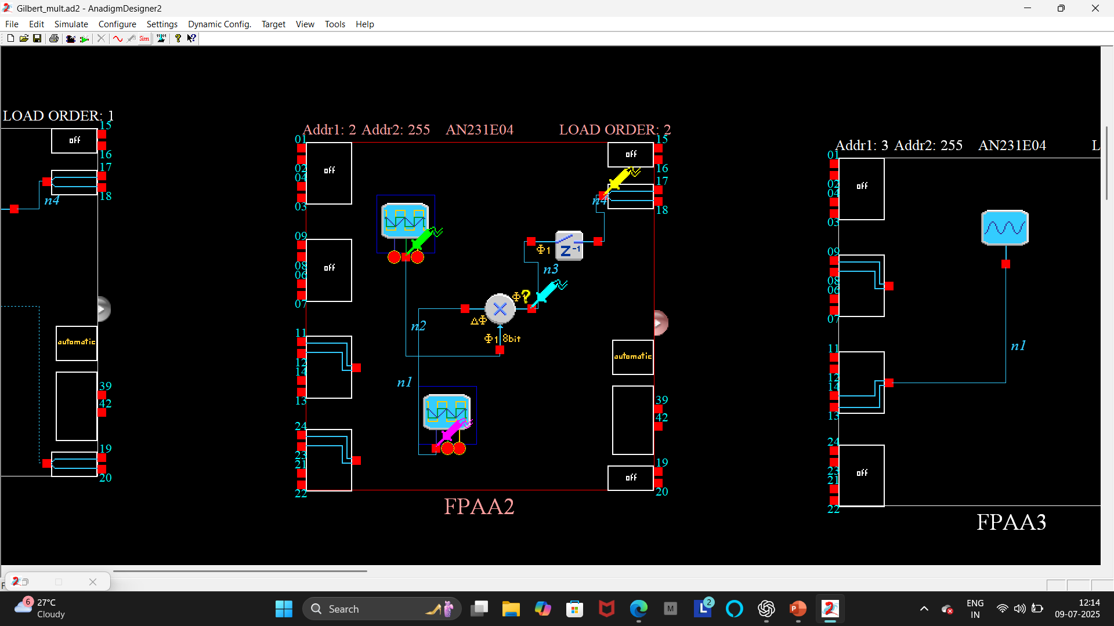
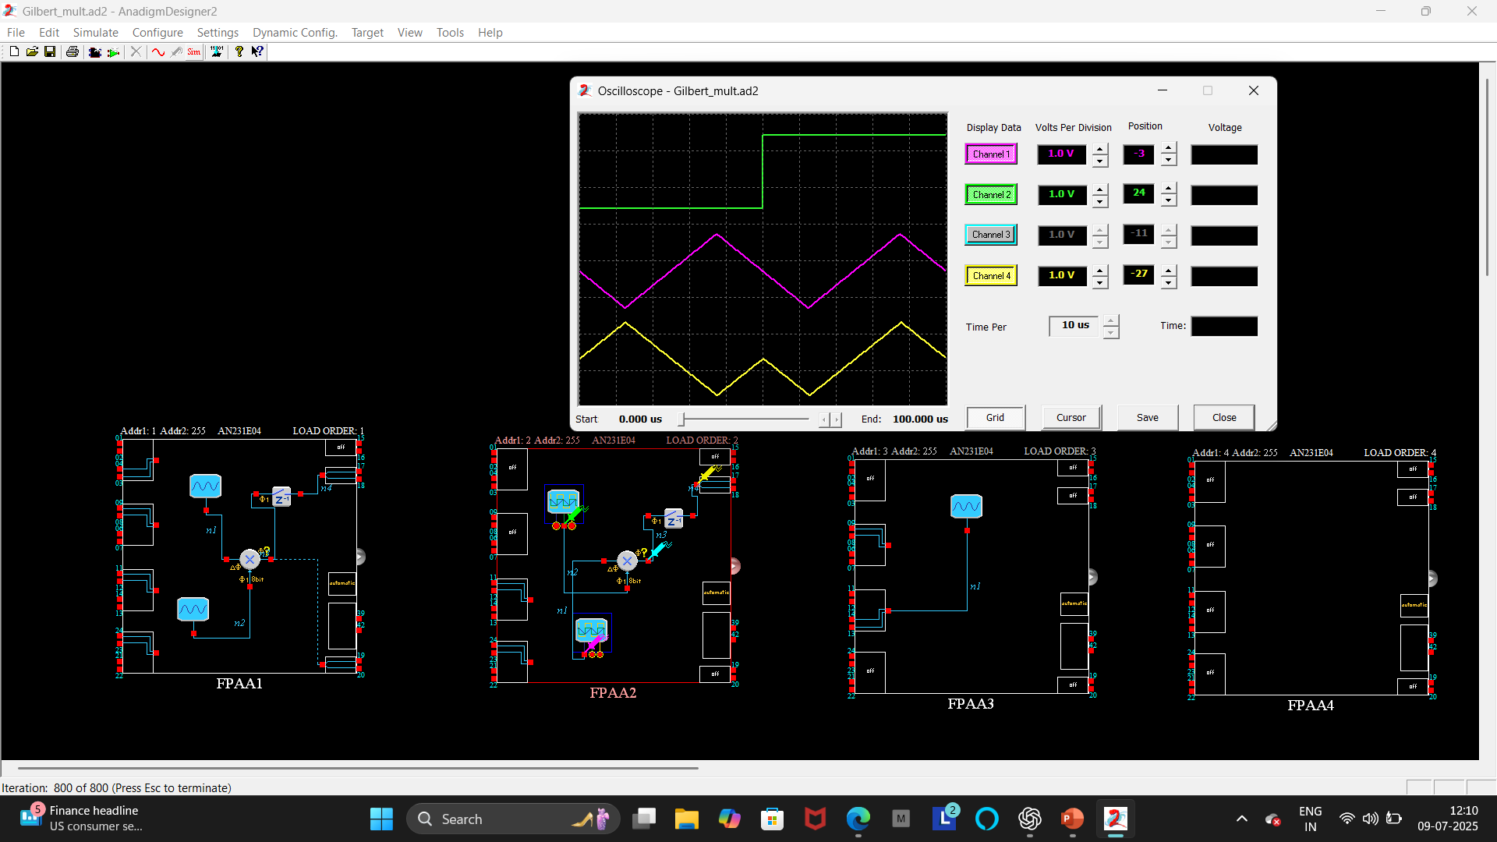
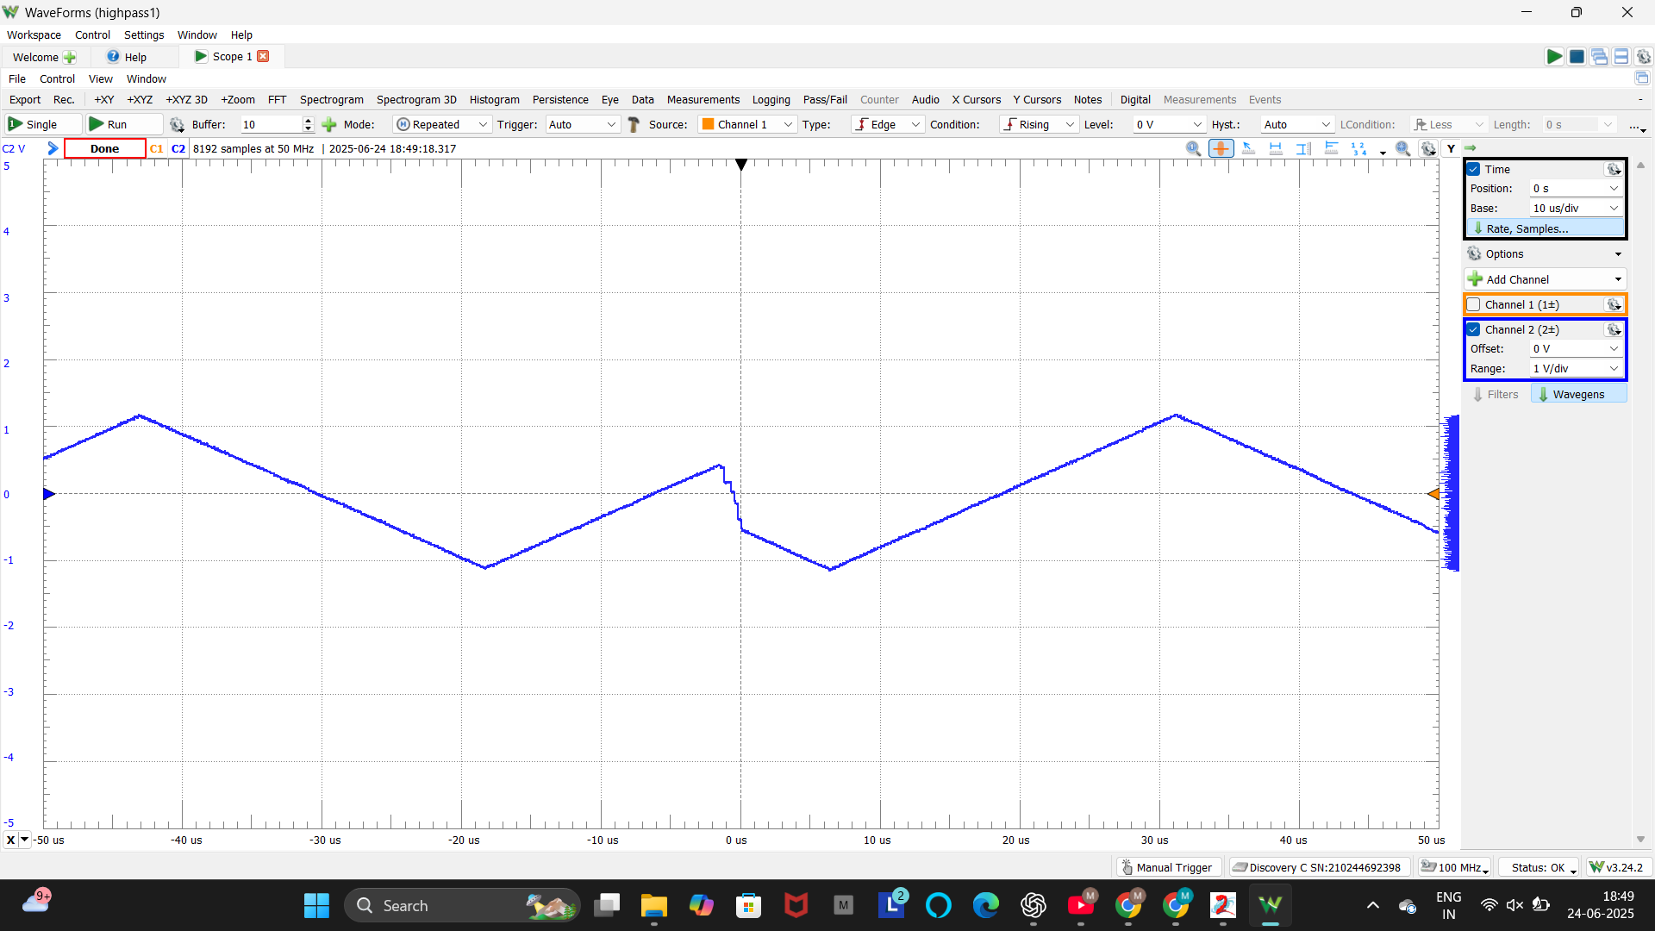
Gilbert Multiplier
Objective: To design and implement a Gilbert Multiplier circuit using FPAA (AN231E04) for analog signal multiplication and mixer applications.
Circuits:
• The Gilbert Multiplier is a key analog circuit that multiplies two
input producing an output proportional to their product. • Circuit uses differential amplifier structure for multiplication.
• The resulting output contains the multiplied signal along with unwanted components which can be filtered using sample and hold.
Working Principle: • The Gilbert Multiplier operates by converting input voltages into currents and mixing them through a pair of differential amplifiers.
• This technique is commonly used in mixers, modulators, and analog and
neural networks.
Result:
• Successful simulation and hardware implementation produced
the desired multiplication behavior.
Sample
and hold
Triangle and square wave Oscillator
Multiplier
Input1
Input2
Multiplier output
Notes:
The Gilbert Multiplier is an important analog circuit that multiplies two input signals, producing an output proportional to their product. The circuit is built using a differential amplifier structure which is essential for performing the multiplication.
However, the resulting output doesn’t just contain the multiplied signal—it also includes some unwanted components. These can be removed or minimized by using sample and hold techniques or appropriate filtering.
Coming to the working principle— The Gilbert Multiplier works by converting the input voltages into currents and then mixing them through pairs of differential amplifiers. This method is widely used in circuits like mixers, modulators, and even in analog computing and neural networks.
Finally, the result— Both the simulation and the hardware implementation using the FPAA successfully produced the expected multiplication behavior as intended.”

Slide 20
References
[1] M. Karmani, C. Khedhiri, B. Hamdi, “Analog Integrated Circuit Design and Testing Using the Field Programmable Analog Array Technology,” International Journal of Advances in Engineering & Technology (IJAET), Vol. 1, Issue 4, pp. 1–9, Sept. 2011.
[2] A. Tomar, M. Kaushik, P. Singh, R. Saxena, “Design and Investigation of a Square-Wave Generator Using Field Programmable Analog Array (FPAA),” Proceedings of the International Conference on Electronics, Signals, and Telecommunication (ICEST), pp. 96–99, 2004.
[3] H. A. Sonawane, A. K. Singh, S. S. Waghmare, “CMOS Gilbert Multiplier for Analog Signal Processing and Its FPAA Based Implementation,” International Journal of Computer Applications, Vol. 95, No. 6, pp. 20–24, 2014.
[4] A. P. Singh, S. S. Bhagwat, “Design and Implementation of Schmitt Trigger Circuit Using FPAA,” International Journal of Engineering Research & Technology (IJERT), Vol. 3, Issue 5, May 2014.
[5] II-I AES Lab Manual

Slide 21


